Slide 1

SURAKHYA
Women’s Safety Route App
EMPOWERING MOVEMENT, ENSURING SAFETY
BY: SWAGATIKA MISHRA

Slide 2
IDEA
Idea is complex, critical and aiming to make the urban area “ Being Safe” & Feeling Safe” ensuring the environmental psychological safety.

Slide 3
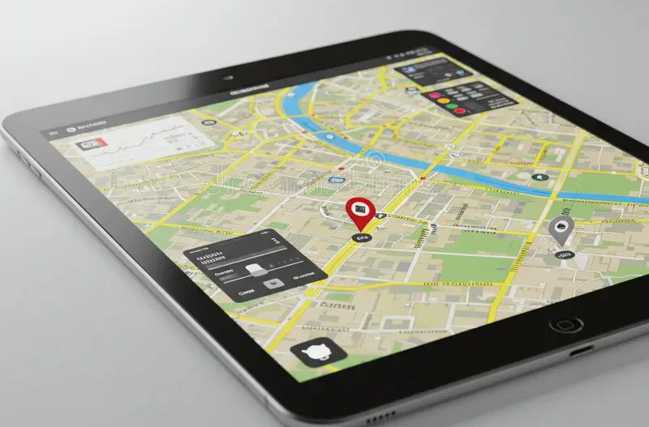
Provide a digital solution offering a safe route for women to commute.

Slide 4
POLICY-ALIGNED, SPEED-DRIVEN
Women's Safety Initiatives by the Ministry of Home Affairs
The Ministry of Home Affairs has launched key initiatives to enhance women’s safety, including a dedicated women’s safety unit to support States and Union Territories in addressing security issues and ensuring timely investigation of sexual assault cases. Women’s safety remains a top priority for the government under Prime Minister Modi’s leadership.
The Emergency Response Support System (ERSS) provides a nationwide helpline (112) for police, fire, and ambulance services. As of July 2023, it has handled 27.10 crore+ calls, with 1123 lakh+ app downloads. The system is integrated with helplines 139 (railway) and 1078 (disaster), and 46% of app users are women.
(Source: Ministry of Home Affairs, Government of India, 2023)

Slide 5









STRATEGY
Parameters
Environmental
Lighting, land use, visibility
Socio-cultural
Community, public activity
Individual
Age, purpose, comfort
User Data Validation
Validate the identified hotspots through annotated imagery in consultations with female residents who have inhabited the locality for more than two decades through a Survey and participatory walking
First-hand Data Collection ( Ground Truthing)
Negative Attributors
Avoiding areas with undesirable features
Land Use
Diverse land use fosters vibrant, active spaces
Density
Higher density can increase social interaction and safety
Natural Surveillance
Eyes on the street create safer environments.
Illumination Level
Well-lit spaces ensure safety and visibility
Trip Pattern Diversity
Designing for diverse age improves safety movement.

Slide 6
DATA MODELING CONCEPT
DATA TYPE
Variables
Scale
Measurements/Numericals/count data
Categorical
Appear as categories (Tick boxes on Questionnare)

Slide 7
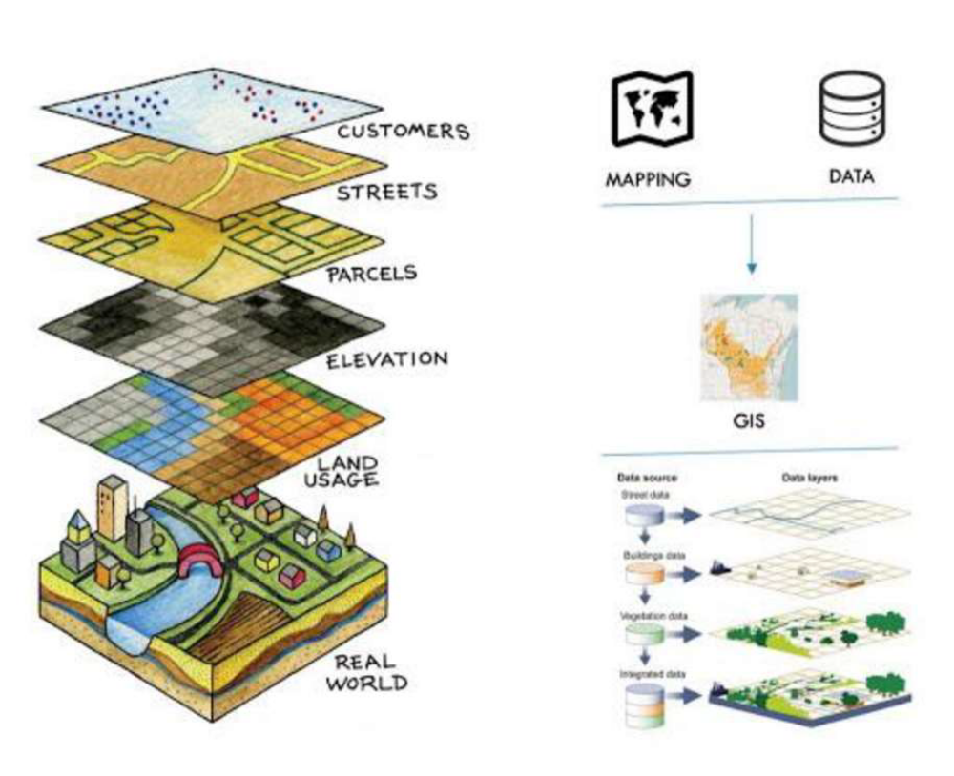
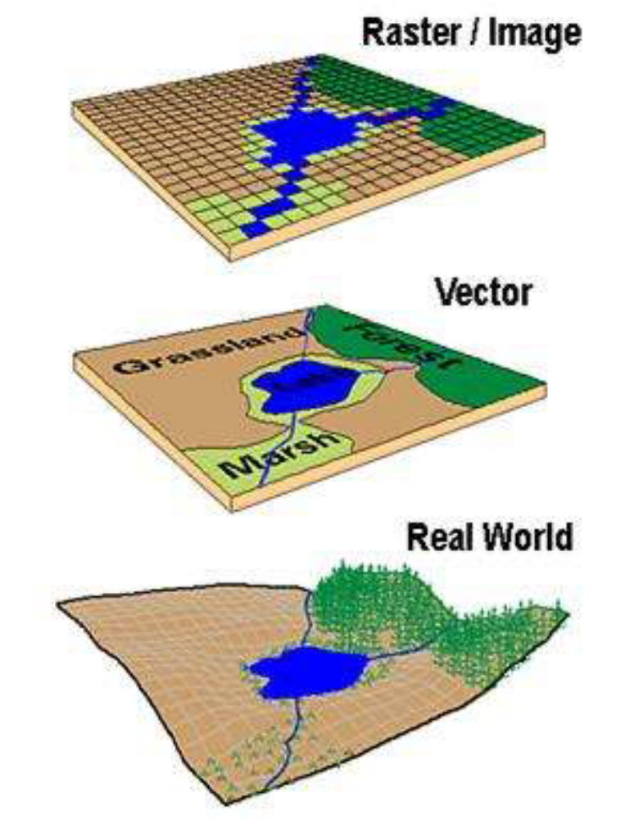
DATA MODELING CONCEPT

Slide 8
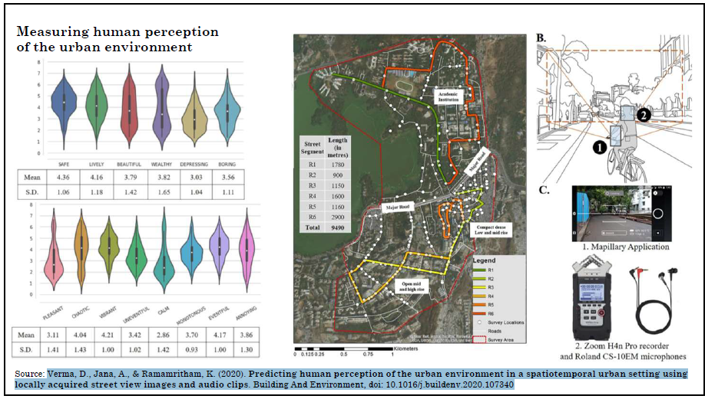
MECHANISM
Integrate subjective survey data into a spatio-temporal mapping framework. Based on identified hotspot zones, the application will assess and notify the user of the likely safety conditions of their current route. If the route is deemed relatively unsafe, the system will automatically suggest an alternative, safer path."

Slide 9
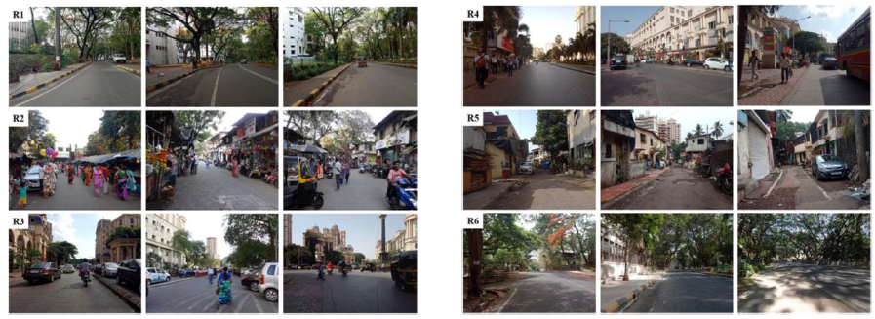
MECHANISM( Annotated Imagery)
Data Collection Method: The website used to collect votes. Participants were presented with random images from the neighbourhood and voted the perceived safe place by clicking on one in response to the question. Afterwards, they have to add the reasons why they found the picture to be safe.This will lead to the perceived safety parameters.

Slide 10
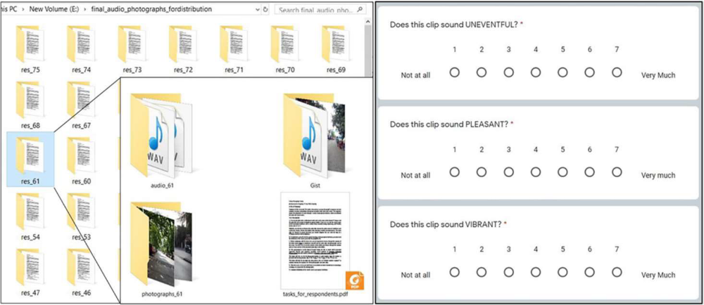
MECHANISM( Sensory Cue)

Slide 11
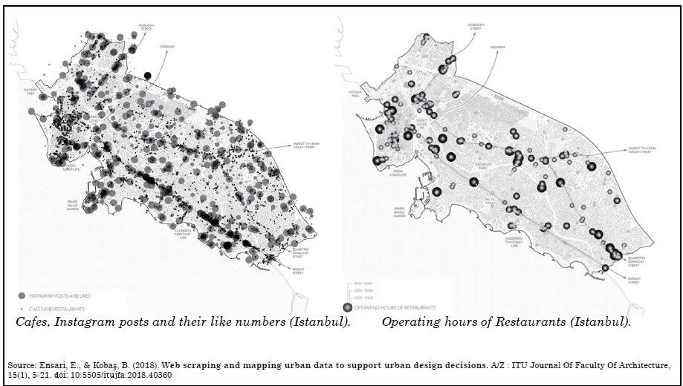
MECHANISM( Activity Pattern)
Analyze user-generated reviews of public facilities along the street network, incorporating operational hours data to evaluate their impact on pedestrian flow and perceived safety levels

Slide 12
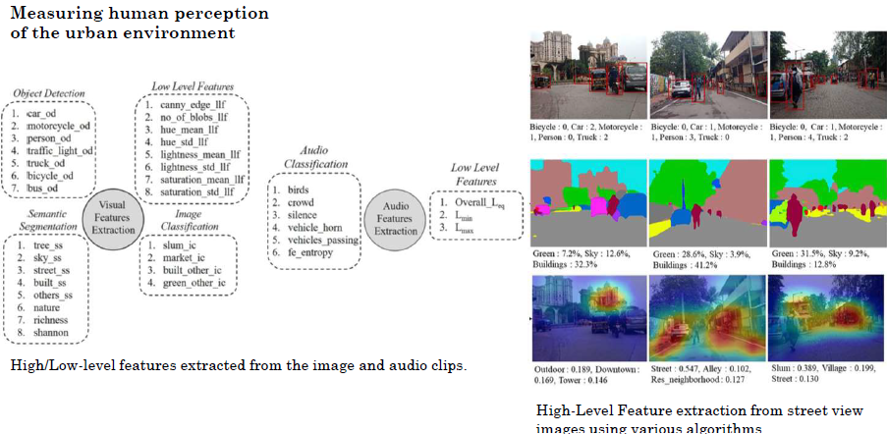
MECHANISM( Data merge & emerging HOTSPOT)

Slide 13
PROCESS
LLM-Based Road Safety for Women
Alerts
Communication
Navigation
Accessibility
Connectivity
Context - Aware Safety Alerts
Feature providing timely warnings to users about potential dangers in their vicinity.
For example, it can alert a user when entering a poorly lit area known for harassment, offering options to notify contacts or change routes.
Natural Language Emergency Interaction
Process enabling users to communicate with the safety app or wearable devices using voice or text in a natural language format.
This facilitates quick and easy communication during emergencies.
Smart Risk Assessment and Route Guidance
The system analyses data from various sources (traffic, crime reports, annotated imagery, hotspot data, user preferences, trip patterns, and route diversions) to suggest the safest travel routes and help users avoid dangerous areas.
Multilingual Support & Sign Language
The app offers support for multiple languages and sign language to ensure accessibility for a diverse user base.
This inclusivity is crucial for widespread adoption and usability.
Integration with Wearables or Mobile Apps
System is designed to integrate seamlessly with wearable devices and other mobile applications, enhancing user convenience and accessibility.
This integration allows for quicker access to safety features and alerts.

Slide 14
ROADMAP
MOBILE/WEB APP (USER UI & INPUT LAYER)
BACKEND SERVER (API GATEWAY, AUTH, LOGIC)
LLM SAFETY BOT (CONTEXT-AWARE Q&A)
LLM SAFETY BOT (CONTEXT-AWARE Q&A)
DATA COLLECTION & FEEDBACK DB
SAFETY SCORING & CONTEXTUAL RISK EVALUATION
ALERT SYSTEM
(LIVE REPORTS, PUSH ALERTS

Slide 15





FUNDING SOURCE
DST
MeitY
MWCD
Department of Science and Technology
Ministry of Electronics and Information Technology
Ministry of Women and Child Development
DST- Women Tech Park
DST- KIRAN
NCW
ICSSR
National Commission for Women
Indian Council of Social Science Research

Slide 16
CHALLENGE & SOLUTIONS
Challenges
Solutions
  Data Privacy and Safety
  Limited Gender-Specific Safety Data
  Bias in Language Models
  Context-Aware Reasoning by integrating GIS
  Real-time Safety Scoring and Routing requires dynamic updates and upgradation
  User Trust and Adoption
- Inclusion of spatial data for hands-on primary data
- By Women Participatory walk & Validation from female residents who have inhabited the locality for more than two decades
- Recurring survey to develop the pattern
- Work on mapping data already available
- Using an annotated imagery survey, develop a database and layer it with crime data for validation and get validated by the user
- Validation by the local female user

Slide 17

Thank you!
KNOW THE WAY. AVOID THE RISK
Presented By: Swagatika Mishra

