Slide 1
Project - Mone
Bridge the digital divide by improving the last mile delivery of LLMs through local dialects

Slide 2
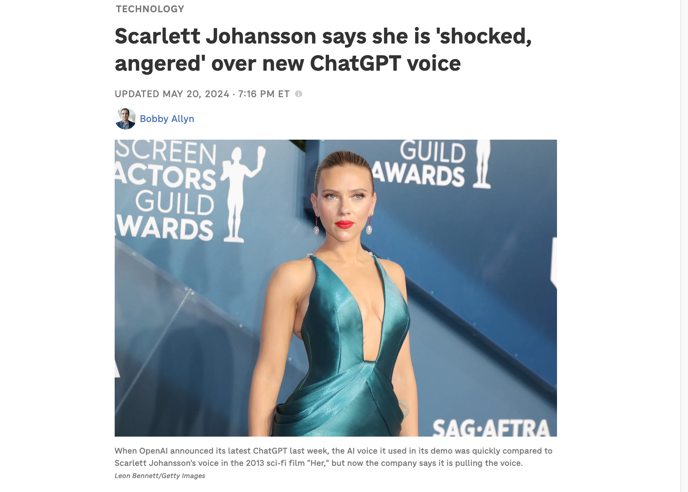
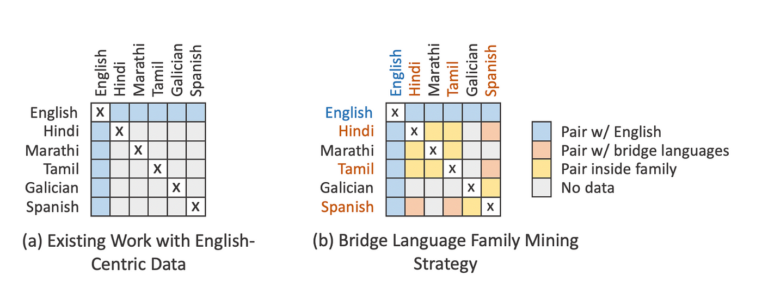
Problems
Most LLMs can take voice inputs, but fail to deliver voice outputs as the delivery gets robotic and monotonous
The audience disconnects from the output
Most LLMs are geared for Anglosaxon languages. Hence, alienating non english speakers from using these amazing capabilities
Most LLM voice delivery output sounds are sourced unethically (Scarlett Johanson is suing Open AI for developing a clone that sounds 99% like her)
Notes:
https://www.bbc.com/news/articles/cm559l5g529o
https://www.npr.org/2024/05/20/1252495087/openai-pulls-ai-voice-that-was-compared-to-scarlett-johansson-in-the-movie-her

Slide 3

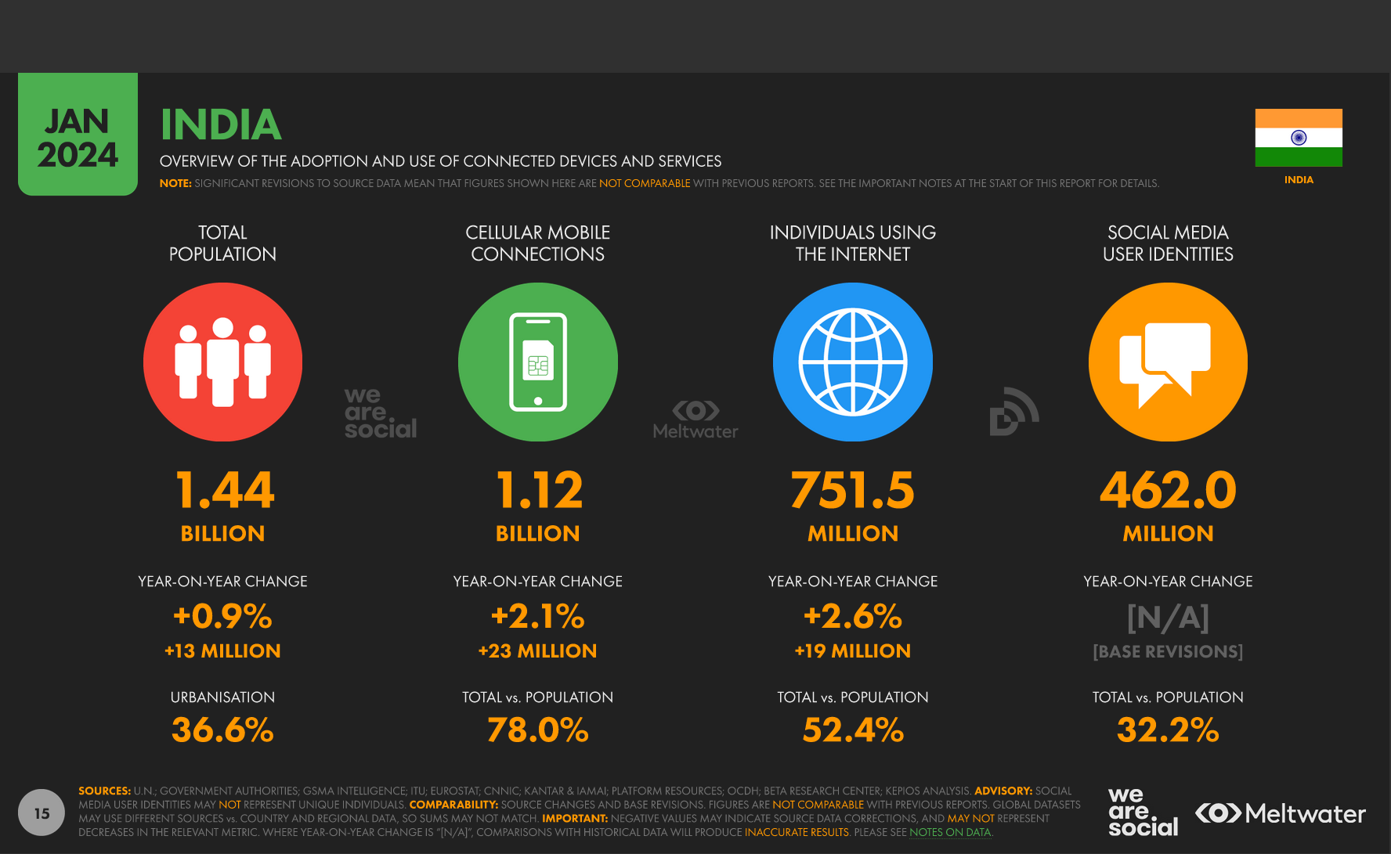

Opportunities – Why now
3 M MAUs. Looking for last mile delivery on AI chatbots to improve customer satisfaction
Notes:
https://datareportal.com/reports/digital-2024-india

Slide 4
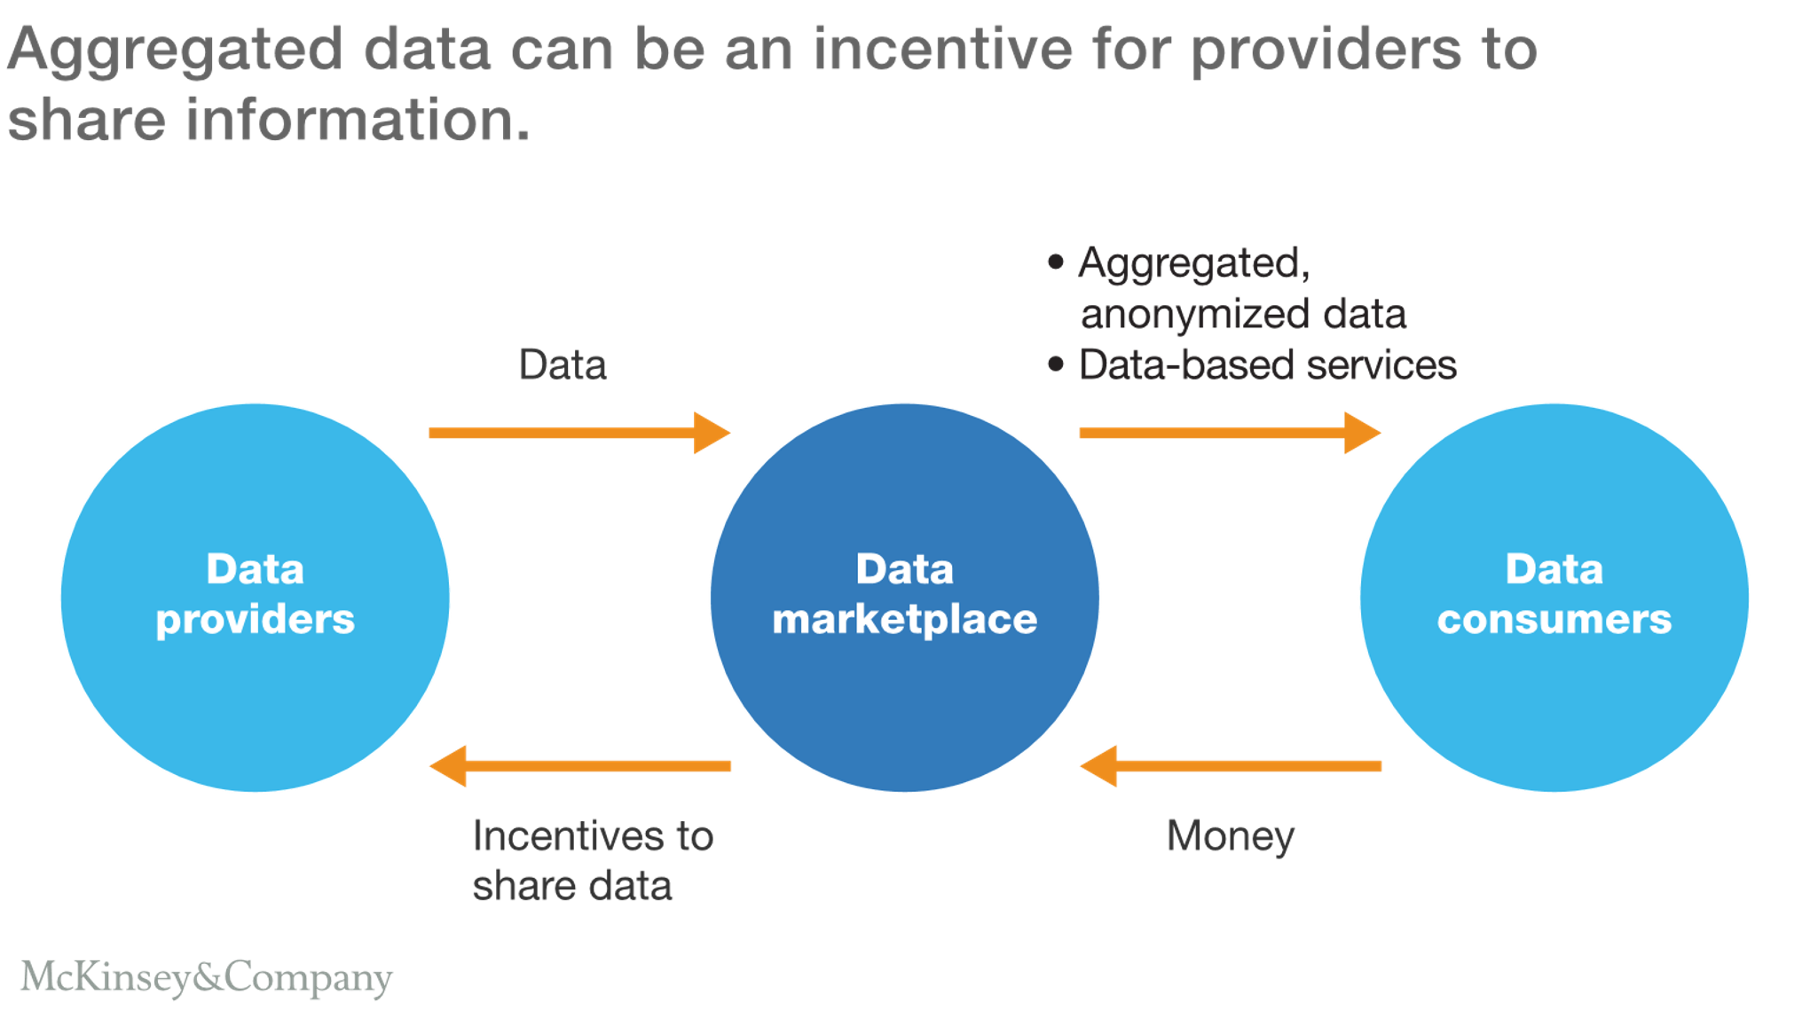
Solution – Voice market place
Aggregated anonymized data & services
Data
Mone
Startups Big tech Govt.
Incentives to share data
Money
Notes:
Pilot it in Kakatiya Sandbox with Suno Sunao – an initiative created by ultra HNIs (have access to 50,000 cotton farmers)
Partner with LLM providers / wrapper startups and add a last mile delivery system where a provider like Bighaat can deliver a agri solution

Slide 5
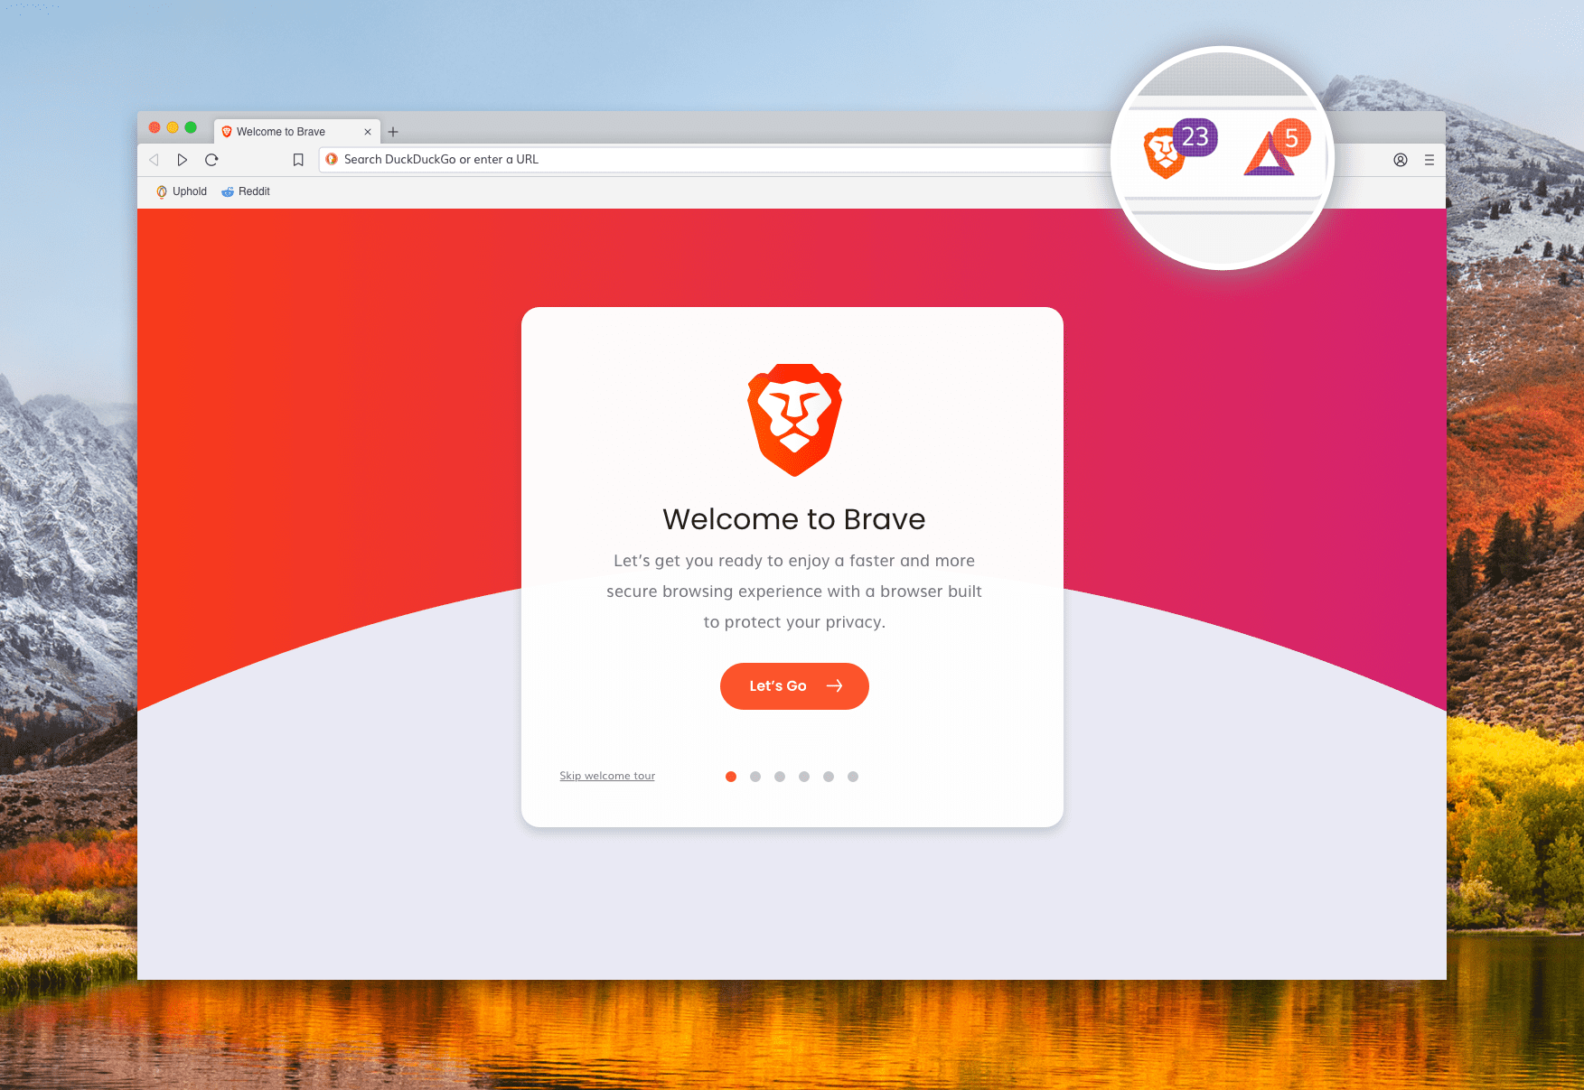
Beneficiaries
Low income households – get paid for tagging and annotating the data
Voice partners – get paid to contribute their voice

Slide 6
What the future beholds ?

Slide 7

What will it look like
Notes:
I have been working on AI projects since I was 13 (want to build JARVIS)
Created MEXT Scholars Association
Scaled it to 20,000 members across 10 countries
Raised $ 200,000 USD in the form of grants and projects (without compromising on the privacy of the members)
Managed to onboard Tokyo government, MEXT, and embassies and private companies in Japan
Invested and worked with deeptech and impact driven ideas, so have a lot of favors that I can cash in with entrepreneurs and investors

Slide 8


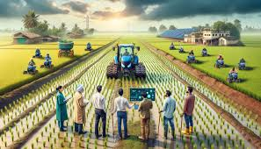

Impact
Employment opportunities for the differently abled – for their voice for audiobooks, dubbing etc.
Healthcare – Streamlined queries in different parts of India
Agriculture and city planning – Improved access to modern agricultural practices and user centric city design process
Notes:
Agriculture – Improved access to modern agricultural practices
Employment opportunities for the differently abled – for their voice for audiobooks, dubbing etc

Slide 9
What the project needs from SGS ?
Access to projects (Civic listening, Suno Sunao)
Advisory board
  Design the guardrails for this project
  Open doors with different stakeholders

Slide 10
Other initiatives in India (potential collaborators)
Reliance Jio Infocomm + Nvidia
Microsoft-Karya Partnership
AI4Bharat (IIT Madras)
MyGov – Corona Helpdesk, MyGov Saathi, Ask VAHEI, Ask DISHA, PAi,
Bhashini, Jugalbandi, Krutrim ai
Suno Sunao – SGS Cohort 2 (they are already onboard).

