Slide 1

Project Enability

Slide 2
Problem Statement
Leprosy is the leading cause of preventable disability in the world.
Delayed diagnosis and treatment leads to severe disabilities, affecting hands, feet, and eye, causing deformities like claw hand and ulcers.
Each year, India reports >100,000 new cases, which is considered an underreported figure
Deformities and disabilities in leprosy lead to significant morbidity, reduced quality of life, and financial burden

Slide 3
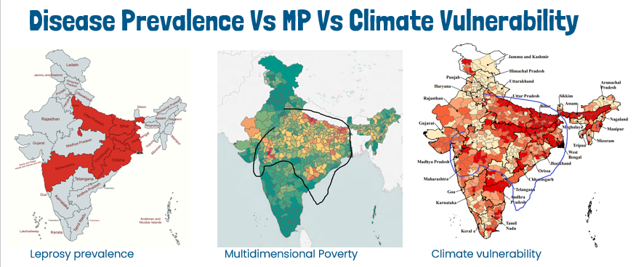
Multiple vulnerabilities coexist

Slide 4
WHO global target for Leprosy by 2030
70%
Reduction in annual number of new cases detected
90%
Reduction in rate per million population of new cases with grade-2 (severe) disability
90%
Reduction in rate per million children of new child cases with leprosy

Slide 5
The need beyond 2030
“Disability prevention, management and care of people affected by leprosy will need attention for a long time, at least till 2047 or beyond.”
Dr V M Katoch
Ex-Secretary, Department of Health and Research, Govt. of India
Ex-Director General, Indian Council of Medical Research ICMR

Slide 6
Pain points of target groups
 | Pain Points | Individuals affected | Caregivers | Health care providers | Govt
1 | Lack of awareness of signs & symptoms of leprosy
2 | Delayed diagnosis leading to deformity, often requiring surgical intervention
3 | Lack of awareness of treatment modalities and relevant service providers
4 | Poor treatment compliance, leading to onset and worsening of disability
5 | Tertiary facilities are concentrated in small areas, leading to accessibility issues.
6 | Lack of awareness of govt. schemes and programs
7 | Unmet need for identifying leprosy hotspots
8 | Local health workers unable to focus on leprosy
9 | Lack of awareness about diverse needs of people affected by leprosy
10 | Geographical remoteness and lack of agency

Slide 7
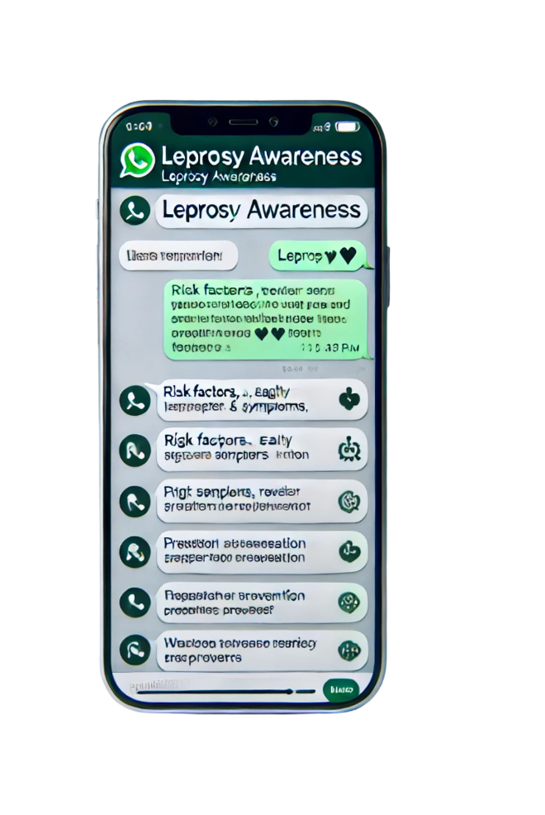
Proposed solution
Awareness of leprosy among at-risk population
Early Identification and diagnosis
Prevent leprosy complications
Ensure treatment adherence and monitoring

Slide 8

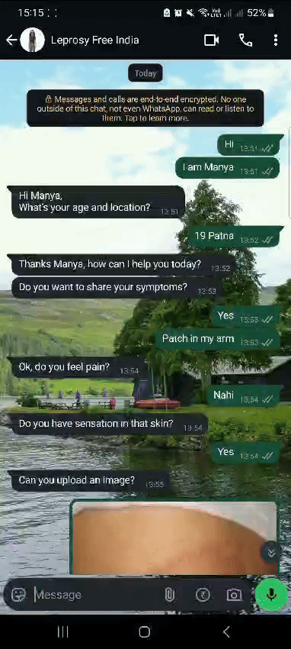
A Minimum Viable Product
Accessible chatbot on messenger platforms (WhatsApp)
AI-powered leprosy screening
Multilingual support to reach grassroots population
Data analytics to track treatment progress and generate insights for health-care providers

Slide 9
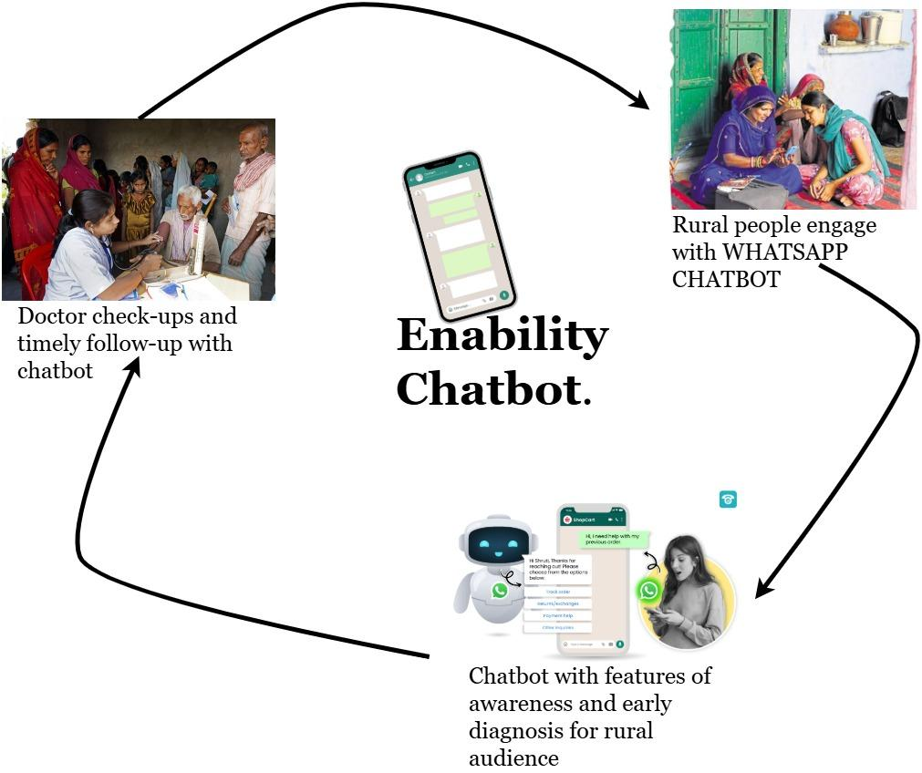
A Minimum Viable Product

Slide 10
Impact we want to see
Increased number of leprosy cases reported due to awareness and nudge
Improved treatment compliance due to regular follow-ups
Reduced cases of Grade 2 (severe) disability
Increased community-level awareness about leprosy
Improved access to disability management services

Slide 11
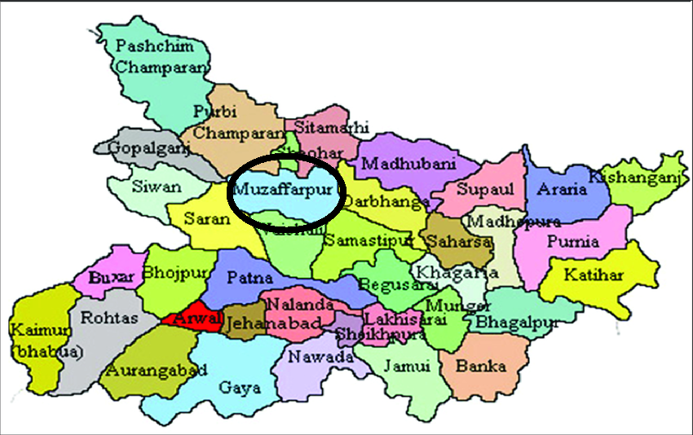
Geography to target and why?
High leprosy prevalence
Population exposed to multiple risks
Awareness of local context
Presence of The Leprosy Mission hospital
Hidden leprosy cases in the community
Few blocks in Muzaffarpur district of Bihar

Slide 12
Implementation Approach
Participatory and Consultative
Consult people affected by leprosy, medical professionals and other stakeholders
Learn from organisations using WhatsApp chatbot
Start small
2-3 high-endemic districts
Focus only on leprosy and related disability
Field-test product prototype with target users and refine the product further before piloting it

Slide 13
Project Roadmap
Assess existing info on leprosy
Interview doctors, service providers, persons affected by leprosy & caregivers
Develop info repository needed for patient care journey
Translate content into vernaculars and create audio-visual versions
Finalise technology partner for WhatsApp chatbot and AI integration
Map user journey on WhatsApp
Set up helpline service
Stakeholder consultation on making the ChatBot intuitive and effective
Pre-pilot awareness drive about the solution
Pilot the solution

Slide 14
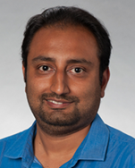

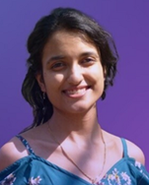
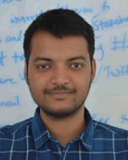
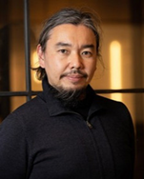
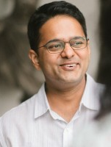
Team
Himanshu Joshi is a Director with NITI Aayog, a premier Govt. of India thinktank, in the Federal Innovation & Entrepreneurship Mission tasked by the Govt of India to build the grassroots startup ecosystem in India. Himanshu is a strategic thought leader with 17+ years of combined experience across Public Policy, Strategy Consulting, Industry, and Startup ecosystem.
Romita Ghosh is a distinguished Founder-CEO at iHeal HealthTech, driving transformative ventures. Her groundbreaking solution, MAAP AI, has earned the prestigious 2025 "AI for Good" award by the UN. Romita holds a double major in biotechnology and biochemistry, an MBA, and is currently pursuing a PhD in Public Health.
Meghana Prakash is the co-founder, CTO, and product strategist of Edgame in India. Meghana is innovative and optimistic, specializing in developing technologies to create social impact. She is an upcoming entrepreneur and a product consultant for startups in India. Meghana graduated top of her class with six gold medals in Electronics Engineering.
Shiv Kumar is a co-founder of Kidaura Innovations. Shiv brings years of experience to the development of innovative childcare solutions at Kidaura. His contributions have revolutionised care for autism and neurodevelopmental disorders, as evident in the products like Kidaura Care and ScreenPlay.
Minoru Sasaki has years of experience in developing projects in the use of digital technologies in public health. He has experience as an expert in the Ministry of Health, Labour and Welfare. Minoru has experience in delivering projects that require collaboration with government officials, legislators, academics, and private-sector businesses.
Subhojit Goswami is a Senior Program Manager Advocacy & Communications at The Leprosy Mission Trust of India. In his current profile, Subhojit focuses on identifying interventions that create Leprosy awareness among communities and enhance their health-seeking behavior.

Slide 15
Thank You

