Slide 1

JAPAN INDIA TRANSFORMATIVE TECHNOLOGY NETWORK (JITTN)
ELICITOR`S ENIGMA
Presenters
Amit Kumar Singh, Advocate
Amrutha Rathina Sampath, IP Analyst & Patent Agent
23rd May 2024

Slide 2
Elicitor`s Enigma
  Background
    The Loss
    The Flow
    The Lost
    The Migrated
  Facts
    Happenings
    Following of Suit
    The Loss yet again
    The Continuum

Slide 3
Explained
Japan of 80s-Riding high on Economic Boom
    US enacts Bayh Dole Act -12th December 1980
    Small Business Innovation Research Development Act (SBIR) -1982
    Small Business Technology Transfer (STTR)-1992
A three-stage system of promoting innovation
Grants at Public Research Places- Upper limit 800K USD
Expansion Grant- Upper Limit 6 Mil USD
Govt Contracts- No upper limit
Big American Companies move with closure of their research labs, aware that there is another innovation system to arrive at Tax Payers` expense, Japanese Follow Suit of closure of CRLs without such backup.

Slide 4
Further
Those senior scientists who were forced to change departments or move away benefitted from three propositions in the US.
In Japan they had to work in different departments, and they moved away to different countries developing them, beneficiaries –Taiwan, China, S. Korea to name a few
In India, brain drain happens at most levels of academia and research as the NIS cannot cater to aspirational, financial and infra needs of researchers
Timeline-1980-2000 (As new patent act came in Japan in 2002, new company law in 2005, New IP court at Tokyo High court and US patent law changed in 2013 from ”First to Invent” to “First to File” )

Slide 5
Lacunae in Terra et in Literature
Gaps at the Ground & Literature
India
Lack of data on early migrators
Lack of data on their composite contribution such as Bose Company (Amar Bose of MIT), Optics, Semi Conductors, etc.
Lack of data on progenitors` creation
Japan
Senior Scientists never have expressed what could have been and could be done
Flaws in BASIC programs
Flawed copy of Bayh Dole, SBIR, STTR
Lack of data on HNI movement and their contribution

Slide 6
The Processual Flow with the skeleton
India
Japan
Find Indian`s Work
  Patent
  Non-patent literature
  Mentionable work
  Further plotting
  Extractions of Actionable intelligence
Fining Japanese` Work
  Patent
  Non-patent literature
  Mentionable work
  Further plotting
  Extractions of Actionable intelligence

Slide 7
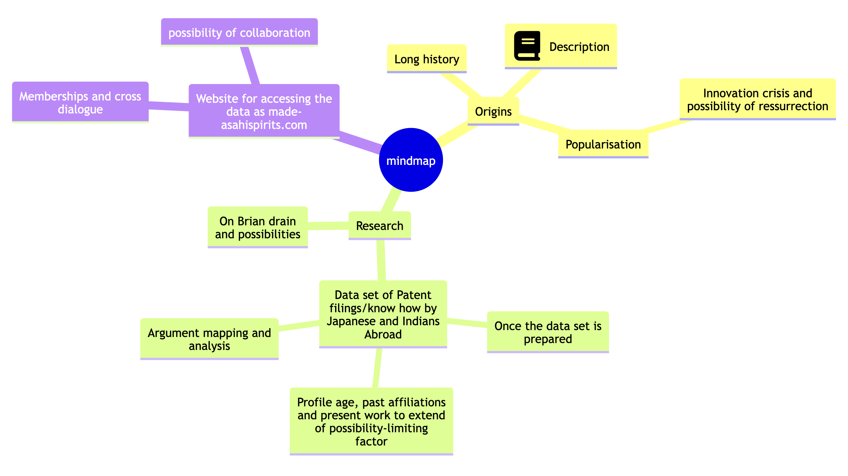
FLOW

Slide 8
Deliverables
Research in Motion
Collection and Plotting of Datum
Research Papers
Interactive Network with blessings of Elicitors
“What they wished” & “What can be done now”
Active Contribution from willing Elicitors, giving them new space where their voices will reign supreme
Collaborative platform

Slide 9
Execution and Locus
“www.asahispirit.com
The structure
1- Background
2- Delivered research with metadata
3- Engagement space
4- Media engagement funnel with SNS and non-SNS niche spaces
5- Advertisement space for academic and research spaces, opportunities and guidelines
The domain name is retained and development can be done in two days (the skeleton) and full work in due course as evolution happens

Slide 10
Needs
The proposers will be able to cover the intellectual and creative requirements
Costs
Website- 15 USD per annum(Domain Name) booked for 2024
Platform Development-200 USD per annum
Research- usage of platforms and researcher engagement to be computed

Slide 11
Support
Suggestions
–Tools of data utilisation
-Tools of mapping
-UI/UX advice
-SNS and Non-SNS related advice
-Other tech and non-tech advice
Access
-Agency support to allow better reach to researchers
Better reach to data of who retired from which company primarily access to NTT will be great
Any other access to principal actors and or agencies for better reach on the backend (development of project and/or ) front end (deliverables and engagements)
Covering the initial costs (Beginning 4,000 USD, Continuum 500 USD per year, for a decade 8500 USD and a buffer of 1500USD in addition )

Slide 12
Thank you for your patience and understanding
Regards !!!

