Slide 1

Japan-India Transformative Technology Network 2024
ENability
By Hari, Himanshu, Karthik, Kateryna,
Romita, Subhojit

Slide 2
Challenges we are addressing
28 million people with disabilities (PWDs).
Lack of awareness and sensitivity to diverse needs of PWDs
Lack of social inclusion of PWDs
Lack of reliable and easy-to-access data on medical and social needs of PWDs
Disparate sources of information on rights and social entitlements of PWDs.
Poor treatment compliance, worsening of disability.

Slide 3
What is your proposed solution?
Explanation for signs & symptoms
Contact details of specialists / institutions
Instructions on what questions to ask a doctor
Dos and Don’ts (treatment adherence)
Reminders for medicines and follow-ups
Reminders on looking for complications and side-effects
Interactions with counsellors or helpline
Positive testimonials of recovered patients
Acknowledge effort of the caregivers
Explainers on accessing social schemes
Reminders to go for early diagnosis

Slide 4
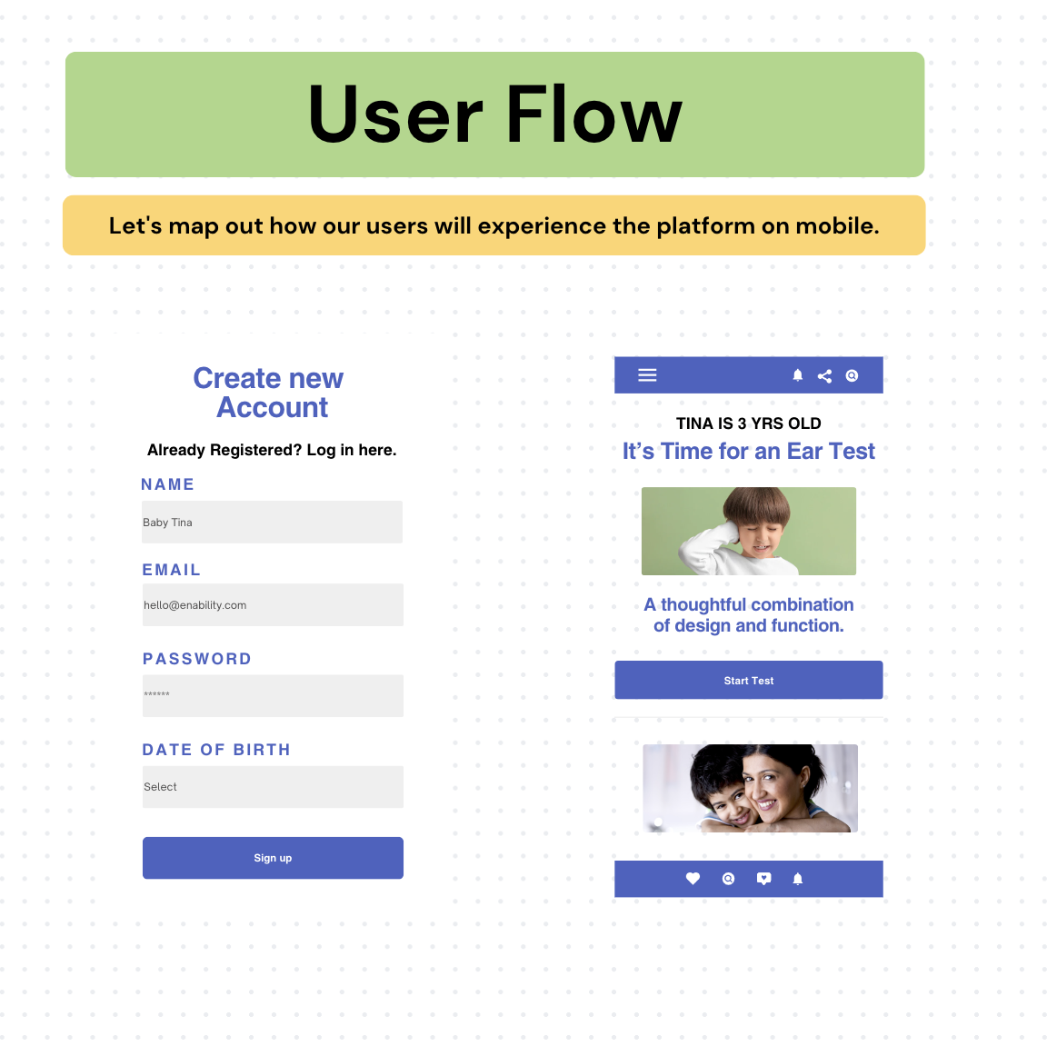

Slide 5
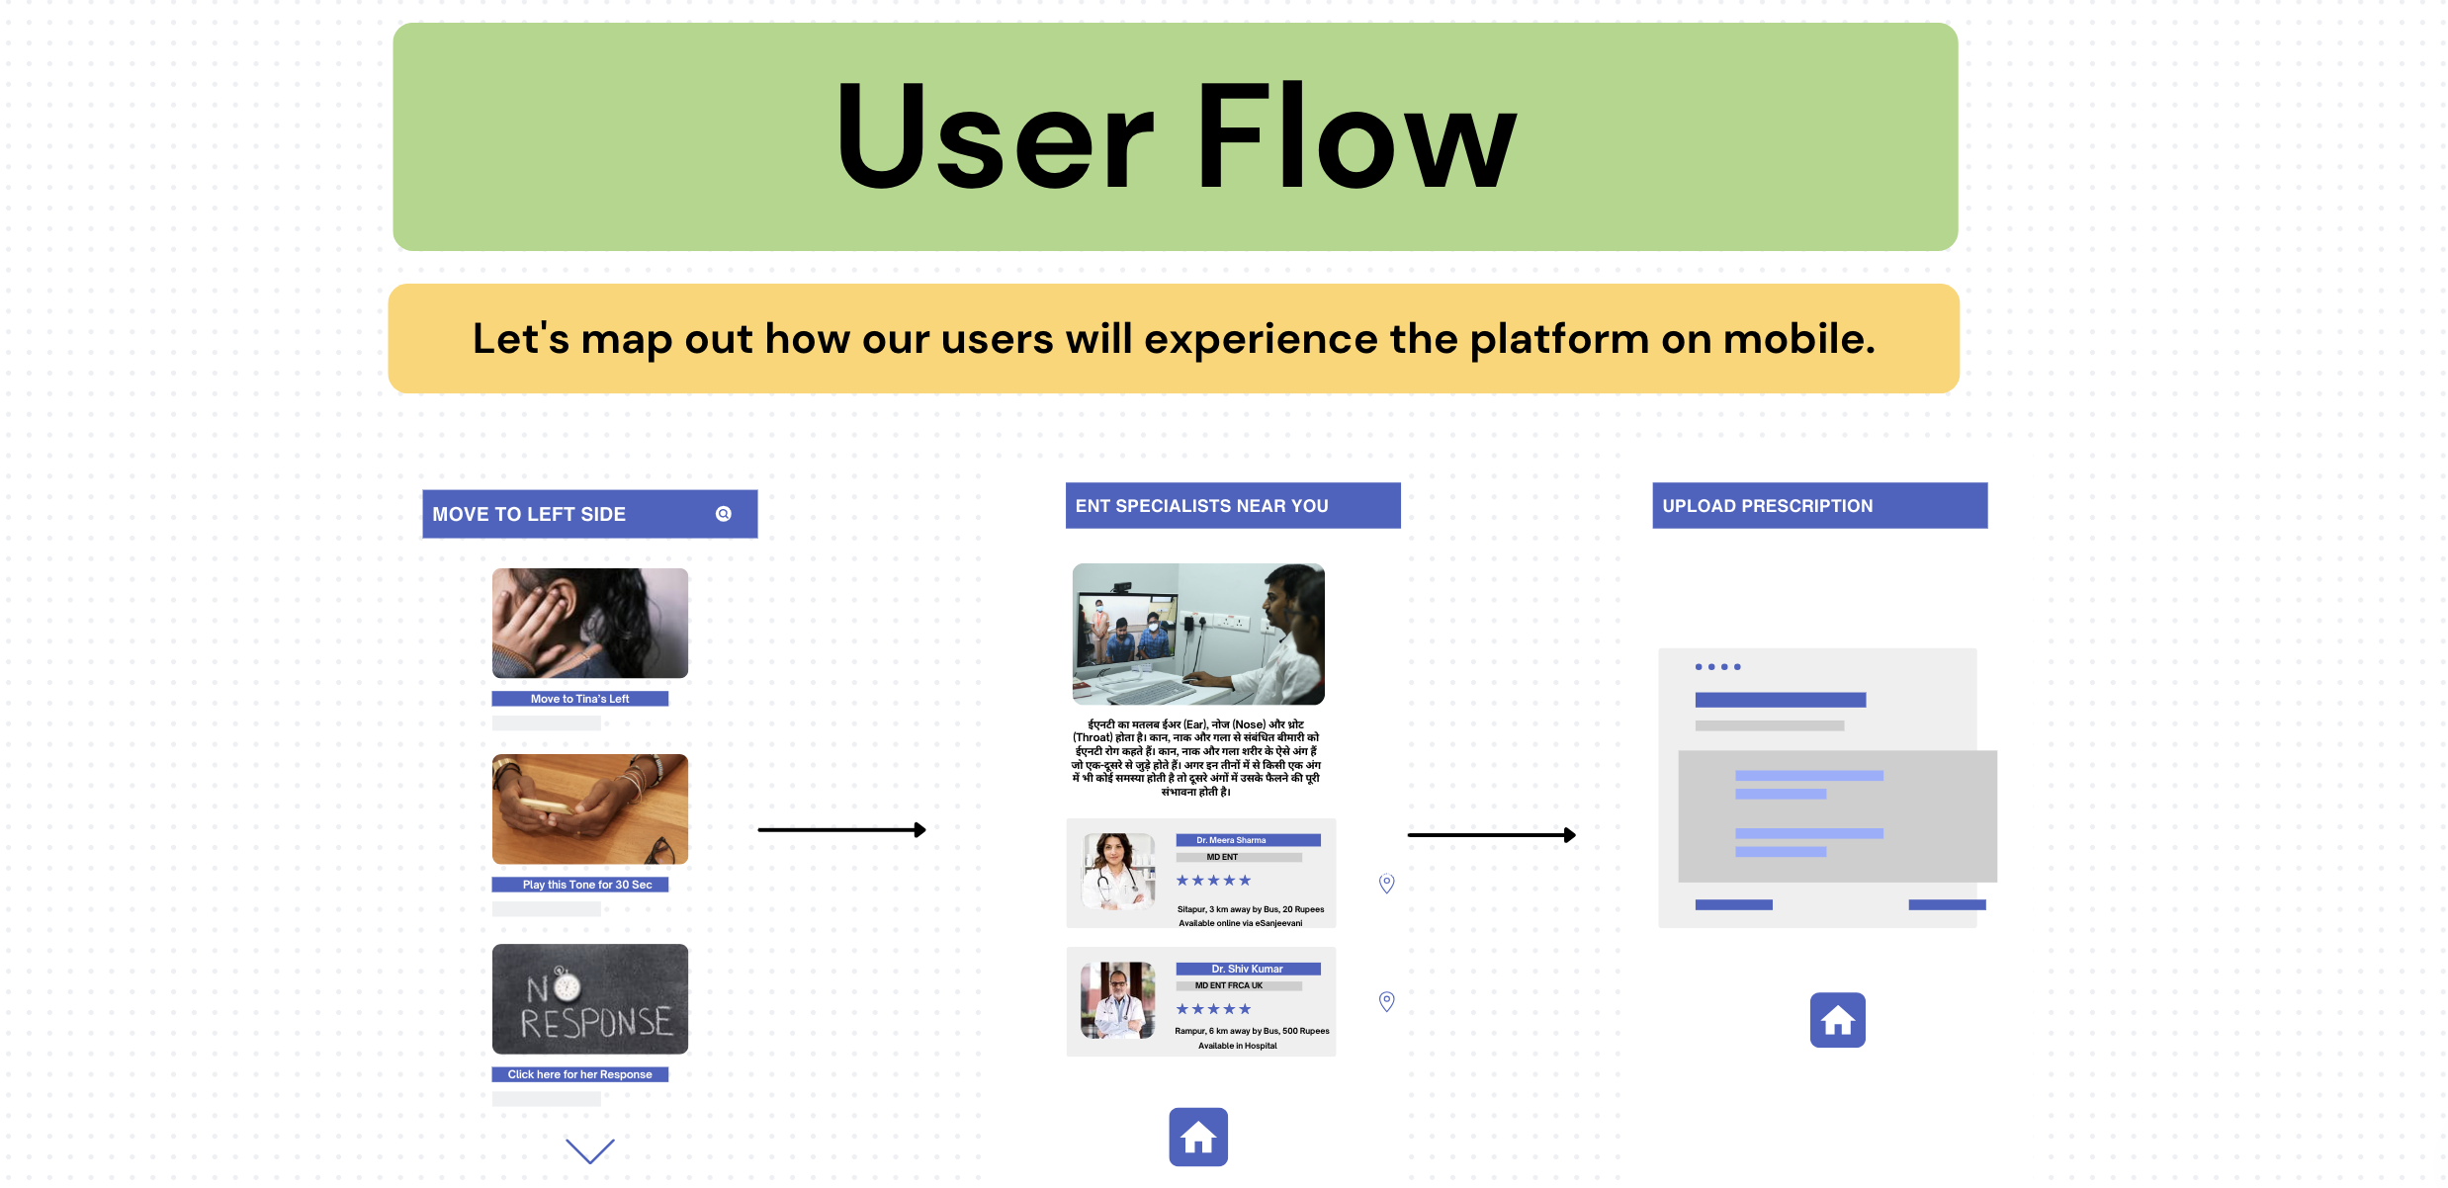

Slide 6
What support do we need from other fellows?
Resources we need
Disability-specific data
Data and perspectives from Japan
Connections with govt orgs / researchers/ disability networks
Data on doctors/ service providers
Tech Stack
Onboard Doctors + caregivers in the team
Disability Inclusion consultants
Mentors +advisors
Legal and compliance advisors

