Slide 1
Passing the parcel
Project Note
10 May 2025
Stories of conflict, visions for peace
Prepared by:
Ankita Singh Rathour
Darshatha Gamage
Dominik Balthasar
Contact:
dominik@balthasar-online.de

Slide 2
Problem statement
Peacebuilding frequently remains
  abstract & conceptual
  top-down & filtered through external narratives
  problem-focused & past-rooted
  isolated & divisive

Slide 3
solution statement
Peacebuilding can gain from
  being more tangible & approachable
  providing human touch to inhuman conflicts
  focusing on solutions & future aspirations
  creating empathy & togetherness

Slide 4

Journal of Peace
A book that travels the world, collecting entries from different conflict contexts through a plethora of people sharing unique stories of conflict and respective visions for peace
Physical book is accompanied by an online platform, which translates, archives and displays the diverse contributions – to engage and exchange

Slide 5
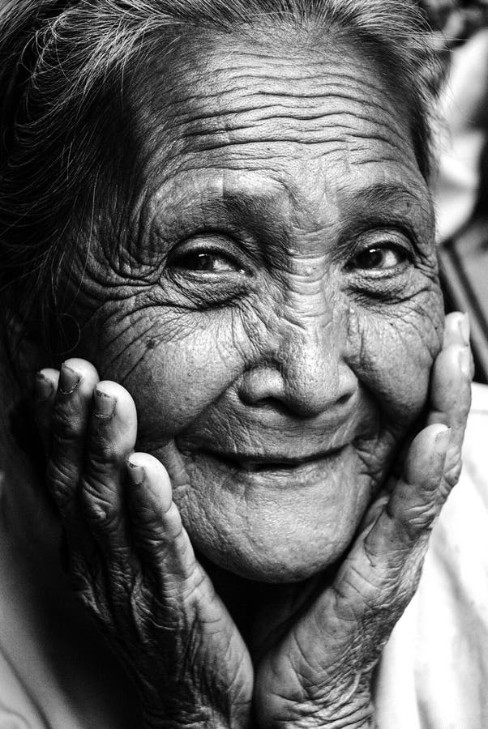
Individual contributions
Contributors will depict personal stories and reflections on their vision for a more peaceful future – from the people, for the people, transcending conflict contexts
Stories are combined with pictures taken by the contributors, visualizing their vision of a more peaceful tomorrow. What does peace look like, what do people aspire to?

Slide 6
Value proposition
  People in conflict: giving them voice & overcoming isolation
  Societies: documenting conflict realities
  Peacebuilding community: stimulating innovation for peace

Slide 7
Envisioned process
Book received by Salzburg Global fellow
Fellow identifies a contributing individual or family
Person contributes through story & pictures/ art, being invited to relate his/her contribution to other stories of the book
Contribution entails own story and their vision on future peace
Book is organized in country chapters with
small introductions into each context

Slide 8
next steps
Ask to Salzburg Global & Fellows:
  Would you be willing to help us write visions of peace?
Next steps:
  Organizing products and logistics
  Mapping the travel itinerary
  Building online portal
  Applying for seed funding
  Party hard! ;)

Slide 9
“Peace is already here. It’s just not evenly distributed”.
freely adapted from William Gibson
Ankita Singh Rathour
Darshatha Gamage
Dominik Balthasar

