Slide 1
Strengthening Community-led Negotiation and Resilience in Myanmar
Cho, Chin, Kar, Win
10 May 2025

Slide 2
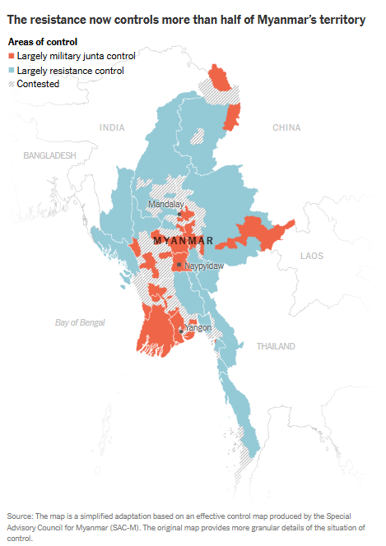
Background
Feb 2021 military coup overturned a democratically elected government, sparking nationwide protests, civil disobedience, and armed resistance.
Since early 2024, resistance groups control nearly half of Myanmar, while the military junta (SAC) holds only about a quarter of the territory
Emerging alternative governance: resistance groups and community-based institutions are filling service gaps in health, education, and justice.

Slide 3
Challenges faced by the Communities
Limited opportunities for negotiations, leading to increased tensions between communities and ethnic armed organisations in terms of livelihoods, taxation and service provisions
Internal divides / Fragmentation among resistance groups and ethnic armed organisations
Limited capacity of the community leaders to (i) undertake proactive deliberations with resistance and ethnic armed actors and (ii) mediation skills

Slide 4
Our Support
APPROACH
OBJECTIVE
ACTIVITIES
1. Research through Horizontal-learning workshops
2. Knowledge Repository
3. Dialogue Sessions
Community leaders equipped with stronger negotiation and conflict mediation skills and toolkits
Local solutions for local problems.
Notes:
Promote hope and healing to build resilience amidst ongoing conflict, Enhance decision-making for community leaders through evidence-based research, Promote hope and healing to build resilience amidst ongoing conflict, Enhance decision-making for community leaders through evidence-based research
Promote hope and healing to build resilience amidst ongoing conflict
Enhance decision-making for community leaders through evidence-based research
Promote hope and healing to build resilience amidst ongoing conflict
Enhance decision-making for community leaders through evidence-based research

Slide 5
Project Details
Areas focus: Sagaing, Magway, Rakhine, Northern Shan
 | Key Activities | Means of Delivery | Timeline
1. | Participatory Action Research and Horizontal-Learning Workshop with Community Leaders | Online workshop | First quarter
2. | Conflict mitigation and resolution skills training and psycho-social support | Online session | Second quarter
3. | Dialogue Sessions for Intercommunal dialogue and Dialogue between communities and armed actors | Online session | Second quarter

Slide 6
Potential uncertainties and mitigation plans
Uncertainties | Mitigation plans
Onboarding local partners Participation of armed actors Internet and electricity accessibility Security risks of local partners/organizations/community leaders | Partnership with well-trusted CSOs Transportation/communication allowance Security protocols for participants
Notes:
Promote hope and healing to build resilience amidst ongoing conflict, Enhance decision-making for community leaders through evidence-based research, Promote hope and healing to build resilience amidst ongoing conflict, Enhance decision-making for community leaders through evidence-based research
Promote hope and healing to build resilience amidst ongoing conflict
Enhance decision-making for community leaders through evidence-based research
Promote hope and healing to build resilience amidst ongoing conflict
Enhance decision-making for community leaders through evidence-based research

Slide 7
Next Practical Steps
Develop an initial framework for the proposed support
Stakeholders mapping to identify potential partners, beneficiaries and geographical locations
Consultation meetings with selected community leaders and stakeholders
Notes:
Promote hope and healing to build resilience amidst ongoing conflict, Enhance decision-making for community leaders through evidence-based research, Promote hope and healing to build resilience amidst ongoing conflict, Enhance decision-making for community leaders through evidence-based research
Promote hope and healing to build resilience amidst ongoing conflict
Enhance decision-making for community leaders through evidence-based research
Promote hope and healing to build resilience amidst ongoing conflict
Enhance decision-making for community leaders through evidence-based research

Slide 8
Specific needs
Expertise on curriculum development and toolkits for community-based conflict mitigation and negotiation.
Funding support for the programs

Slide 9
Thank you!

