Slide 1

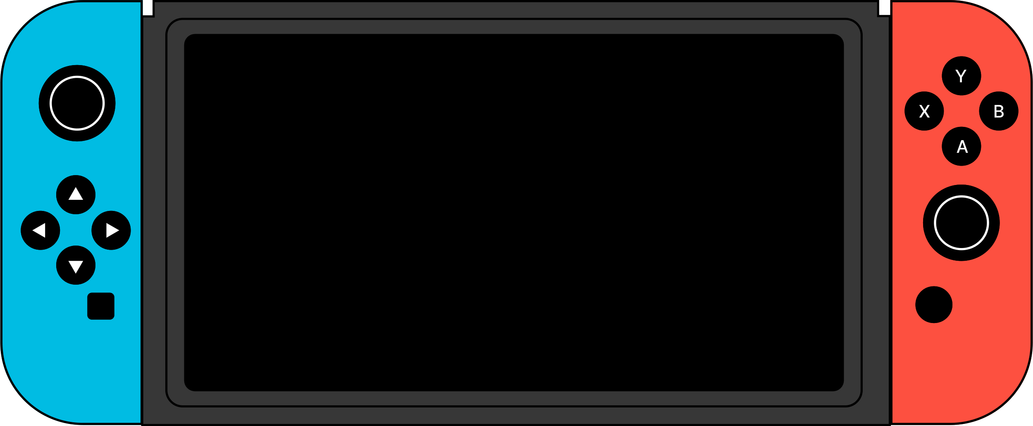









BELONGING, UNINTERRUPTED

Slide 2

Marginalized and Indigenous communities remain unseen, unheard, and unrecognized, excluded from mainstream narratives and denied access to social and climate justice, deepening inequality and social fragmentation.

Slide 3







01
07
12
Traditional advocacy often misses the stories, struggles and strengths of marginalised and Indigenous communities; gamification offers a non confrontational, fun and engaging way to bring these lived histories to life, turning passive awareness into active empathy and action, while offering potential for monetisation, long term sustainability and scalable impact beyond one time initiatives.
WHY
GAMIFICATION?

Slide 4
01
07
12
WHY
GAMIFICATION?
By creating an engaging, fun platform that promotes social and climate justice, the rights of marginalized & Indigenous communities will be heard, seen, and recognized.

Slide 5
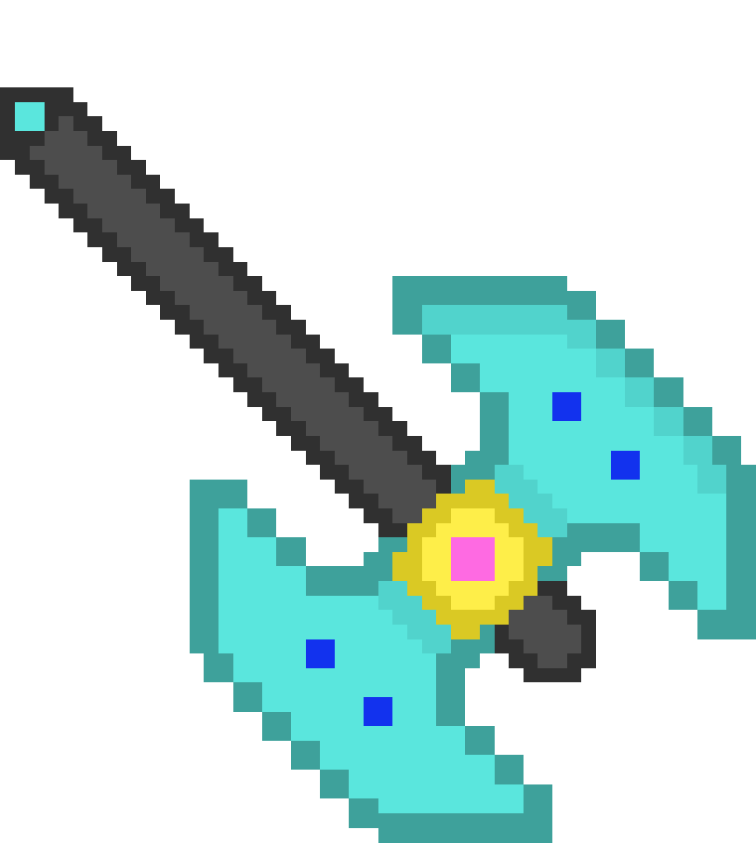




REMAINING QUESTIONS?
01
07
12
Game Format & Content
Community Input &
Narrative focus
Partners/Funders
Scalability &
Sustainability
Impact Measurement

Slide 6




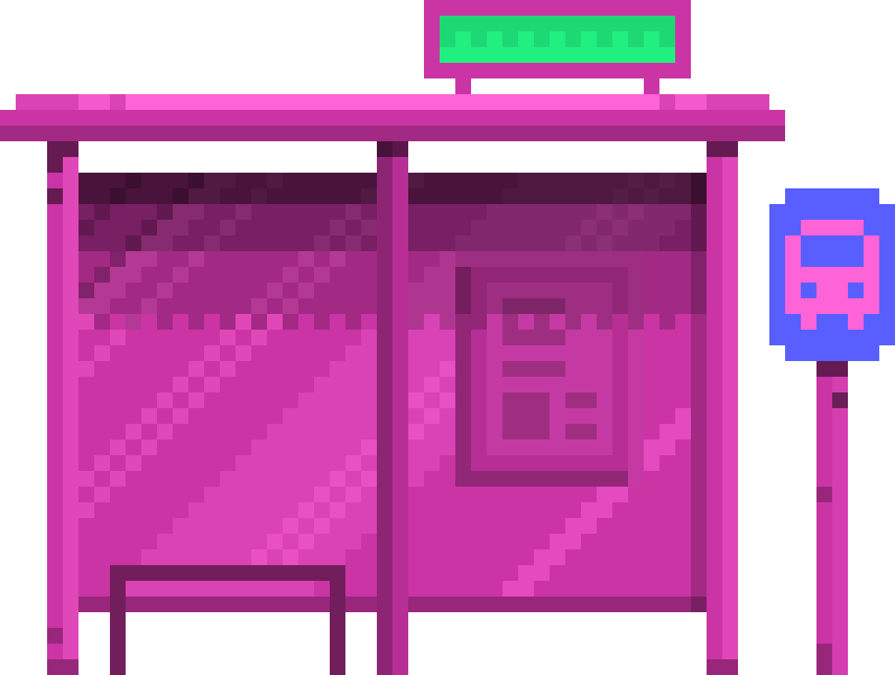

NEXT STEP

Slide 7

Define goals, roles, stakeholders and outline the core game concept.
1
Plan and Budget
Develop a detailed proposal, timeline and budget to guide development.
2
Notes:
1. Align and Scope
Define goals, roles, stakeholders and outline the core game concept.
2. Plan and Budget
Develop a detailed proposal, timeline and budget to guide development.
3. Identify Funders
Research and approach aligned donors, partners and funding opportunities.
4. Engage and Co-Create
Collaborate with communities to shape the content, then prototype and iterate based on feedback.

Slide 8
Identify Funders
Research and approach aligned donors, partners and funding opportunities.
3
Engage and Co-Create
Collaborate with communities to shape the content, then prototype and iterate based on feedback.
4
Notes:
1. Align and Scope
Define goals, roles, stakeholders and outline the core game concept.
2. Plan and Budget
Develop a detailed proposal, timeline and budget to guide development.
3. Identify Funders
Research and approach aligned donors, partners and funding opportunities.
4. Engage and Co-Create
Collaborate with communities to shape the content, then prototype and iterate based on feedback.

Slide 9


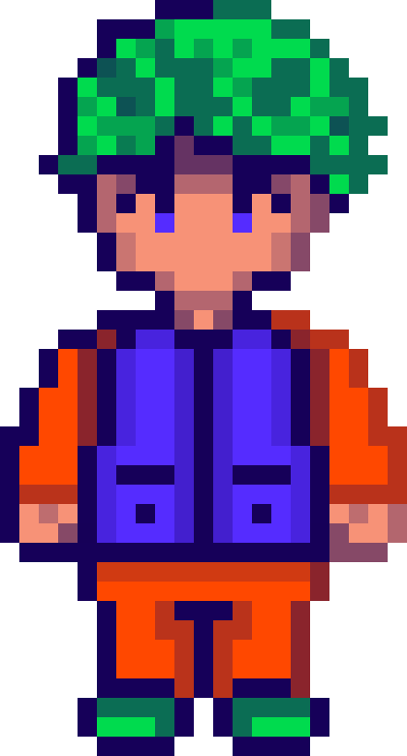

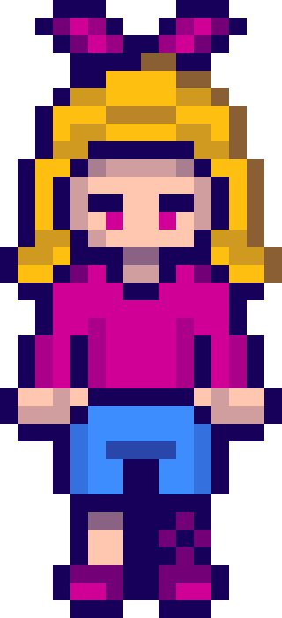

WHAT WE NEED?
Artists & Storytellers – to bring lived histories to life
Gamers & Game Designers – to craft engaging, intuitive play
Legal & Rights Experts – to ensure
accuracy and relevance
Influencers & Advocates – to amplify
reach and impact
Contextual Experts – to ground the game
in local realities
Funders & Partners – to support
development and scale
Notes:
• Artists & Storytellers – to bring lived histories to life
• Legal & Rights Experts – to ensure accuracy and relevance
• Contextual Experts – to ground the game in local realities
• Gamers & Game Designers – to craft engaging, intuitive play
• Influencers & Advocates – to amplify reach and impact
• Funders & Partners – to support development and scale

Slide 10














THANK
YOU

