Slide 1

Confluence 4 Peace
A Virtual Festival
#C4P

Slide 2
SANGAM – The Festival of Confluence
(Same meaning in Nepali, Urdu, Hindi, Bengali)

Slide 3
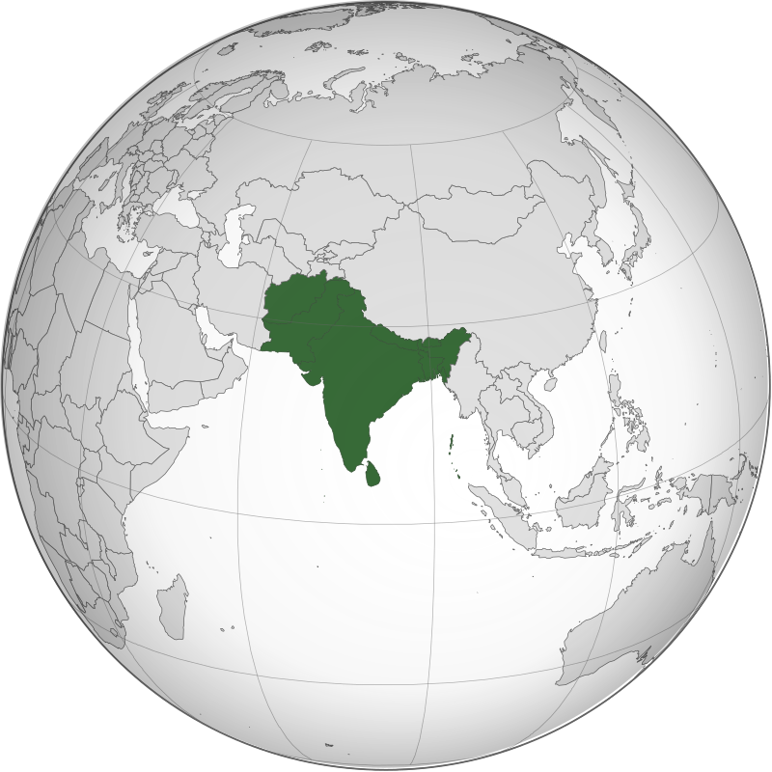
Challenges & Opportunities
Addressing Climate Change
Conflicts
Climate Change
Shared Culture
Risk of Climate Induced Conflicts
South Asia
Young People
(c) Wikipedia
We need to build peace in the region while adressing climate change, leveraging the power of young people and culture
Notes:
We have always heard about unrest and conflicts in the South Asian region! because most of these countries have historically been affected by different types of conflicts. For example, territorial disputes between India, Pakistan and Bangladesh, civil wars in Nepal and Sri Lanka, geopolitical conflicts in Afghanistan, etc
At the same time, our planet is falling apart due to the sustainability challenges such as climate change.
Climate change has the potential to further enhance the possibility of escalation of arms conflicts and unrest in the region. Because climate change leads to resource shortages, pushing nations to compete each other and hence, has the potential to transform cold conflicts into violent conflicts.
We need to work towards building peace in the region! And that is URGENT!
But this is not it!
We can convert the risk associated with climate change as an opportunity to build peace among the south Asian nations by addressing climate change
We all know that in South Asia we also have shared culture and youth bulge which can also feed into the peace building efforts

Slide 4
“SANGAM – The Festival of Confluence”, it is a festival that represents a meeting point of ideas, cultures and civilizations by empowering youngsters and adolescents as change agents for sustainable peace and sustainable development in South Asia.
Our Project
Notes:
Developing peace-building dialogues, roadmaps, bridges, and strategies centered around sustainability challenges will help nations identify the conciliation benefits, as climate change is already affecting the entire region, with no borders attached.
As future generations have more to lose, therefore we bring together youngsters and adolescents, with an emphasis on the shared cultural characteristics of the South Asian region, to introduce the next generation of change agents that will focus on creating common projects, sharing ideas, and engaging with local governments, and thus, be the seeds of peacebuilding while trying to overcome the challenges associated with climate change.

Slide 5
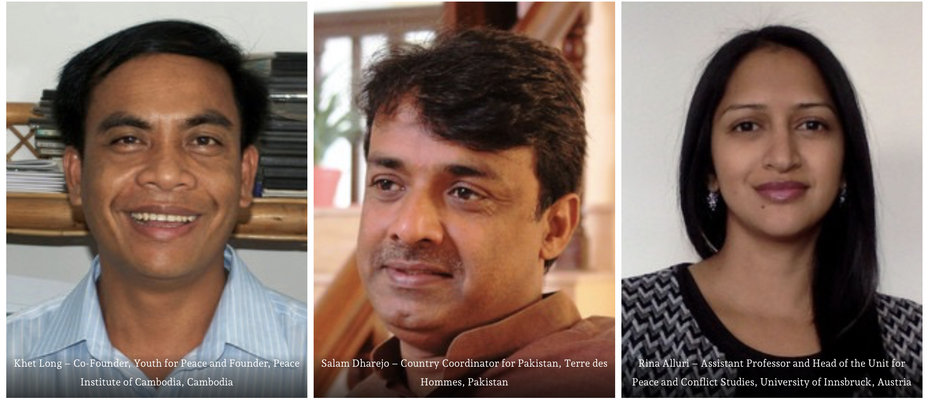
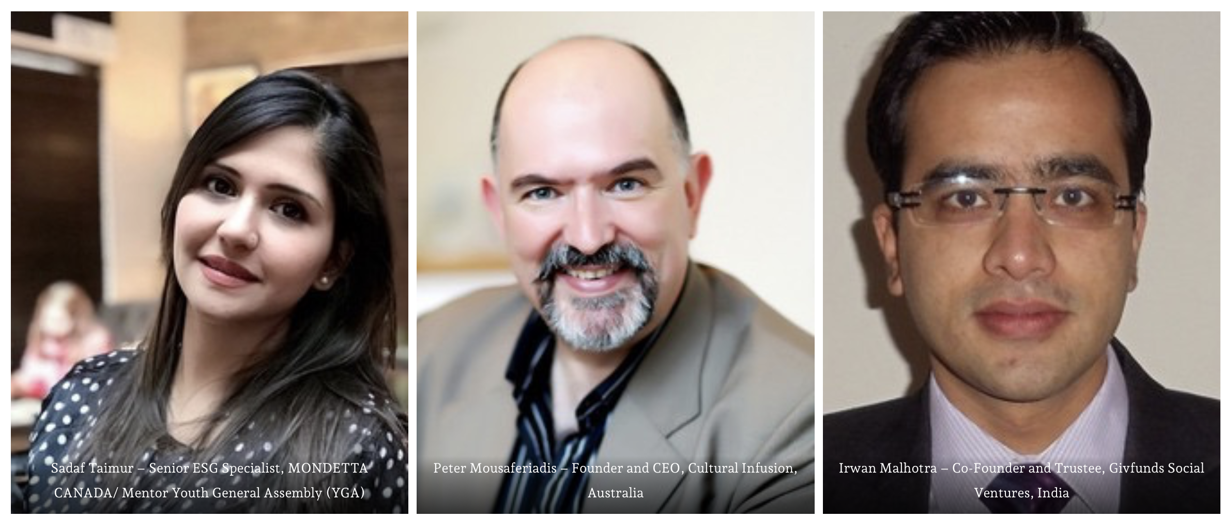

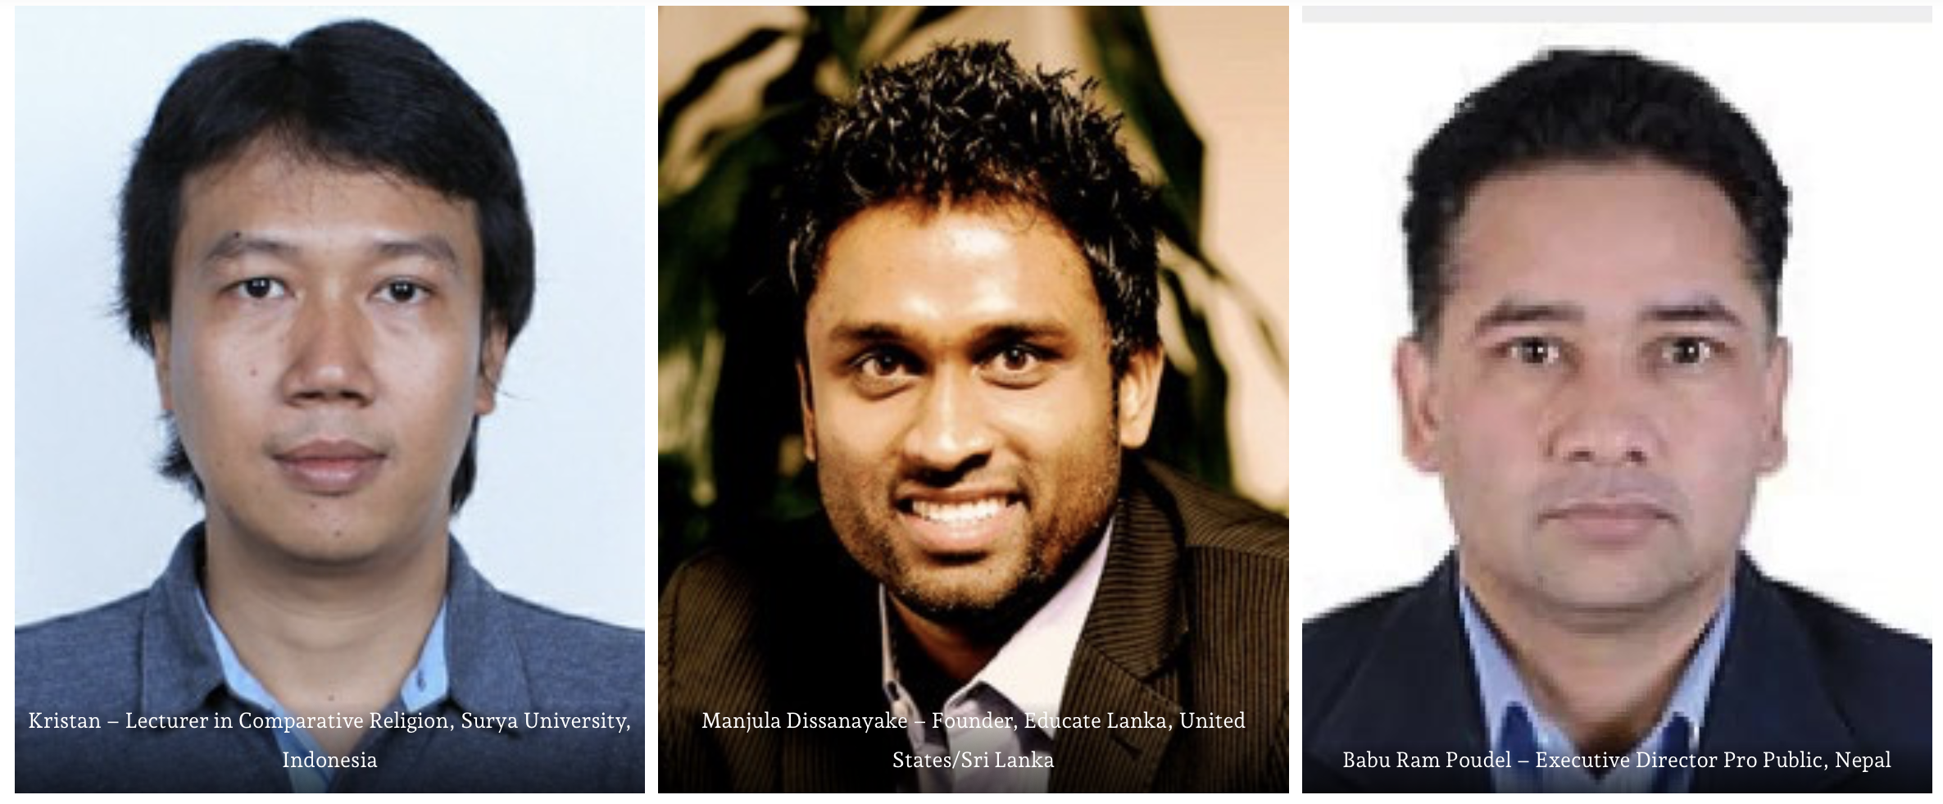
Project Team

Slide 6
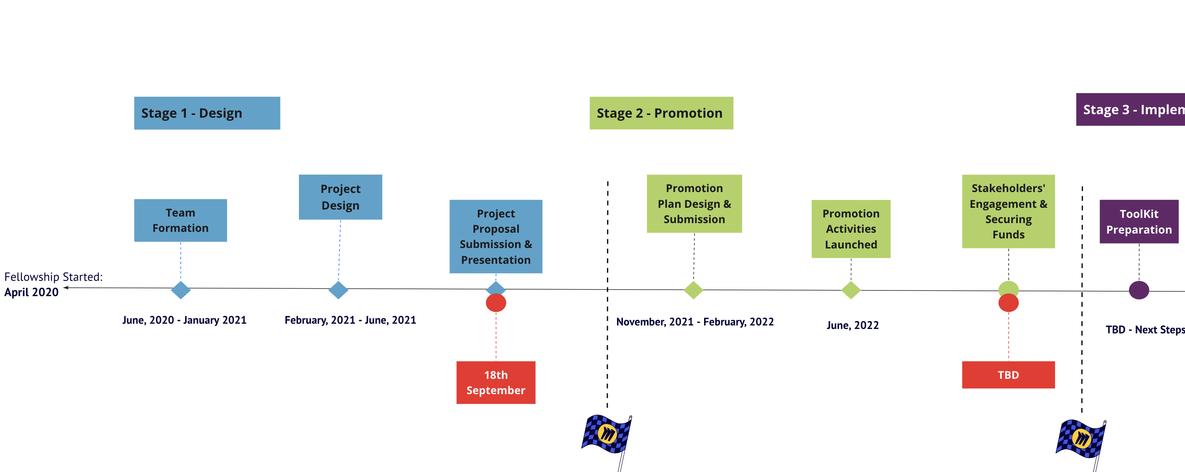
Timeline

Slide 7
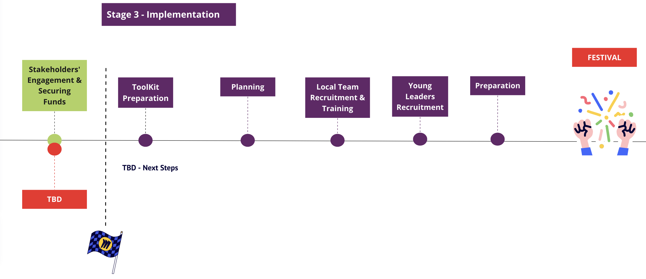
Next Steps
2nd & 3rd Dec, 2023

Slide 8

Challenges & Opportunities
Explore Existing Resources/Partners
Local Team – Already Engaged
Promotional material – Promotional Phase
Funding
Time & Committment
Social Media/Website Material

Slide 9

Festival with Youth General Assembly, Pakistan
Youth General Assembly ==> grassroot movement contributing to the top-level political changes in the country via training next generation of civic/political leaders and ambassadors – Social Enterprise
Every year, Youth General Assembly recruits around one thousand ambitious members across Pakistan. Till now, we have 7000 alumni and more than 1000 active members.
Confluence 4 Peace was organized as one of the sub segment of Beyond the Youth.
https://ygapakistan.org

Slide 10

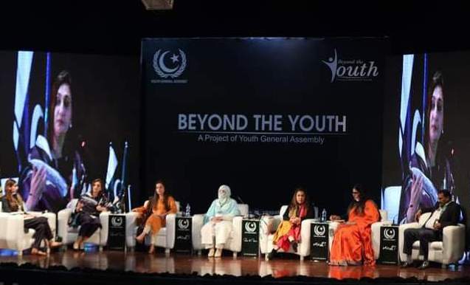
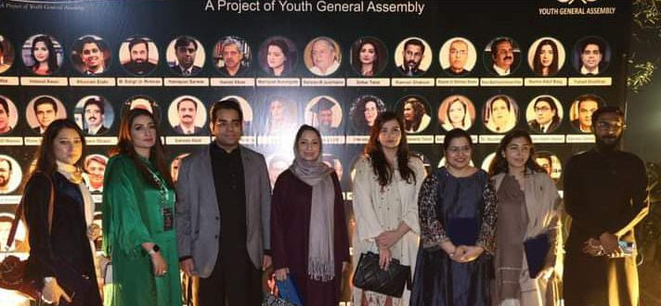
Beyond the Youth(BTY)
Beyond the Youth (BTY) is a flagship event of the Youth General Assembly.
Every year (for last 8 years) - BTY provides a platform for the youth to present their ideas and policies to eradicate the socio-economic problems in the country.
Climate change and peacebuilding have remained the most discussed topics in the country and therefore, we planned to introduce a new segment to BTY i.e., “Confluence 4 Peace”

Slide 11
Rationale
Focusing on Bigger Picture
Achieving the Objectives of the Proposed Project
Ensuring Sustainability
Making an Impact
Confluence 4 Peace – 2nd & 3rd December, 2023

Slide 12
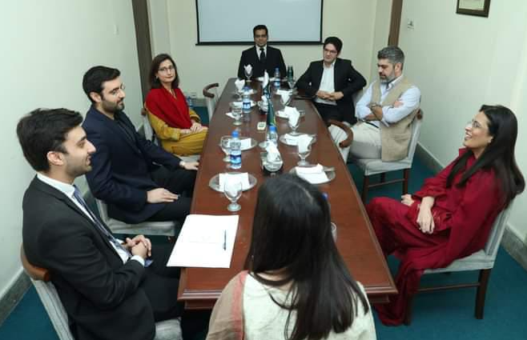
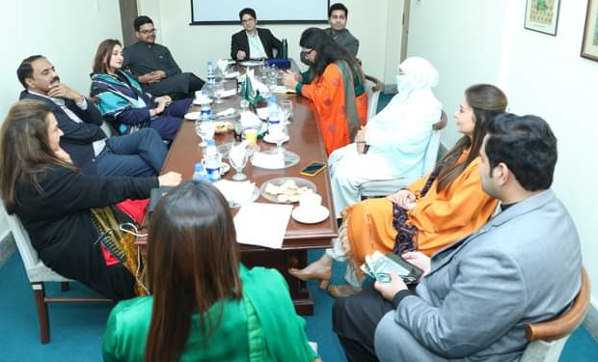
Toolkit
Prepared in consultation with young people, who are the engaged members of Youth General Assembly.
The purpose of the toolkit is not telling young people what to think, rather to think critically about the world around them!
28th July, 2023
3rd August, 2023

Slide 13

Toolkit
Key Aspects:
  Conflict is an inherent part of the human condition-how it is related to climate change
  Geographies susceptible to the climate induced conflicts and commonalities between them
  Leveraging the power of commonalities to deal with the climate induced conflicts – talking about the future

Slide 14
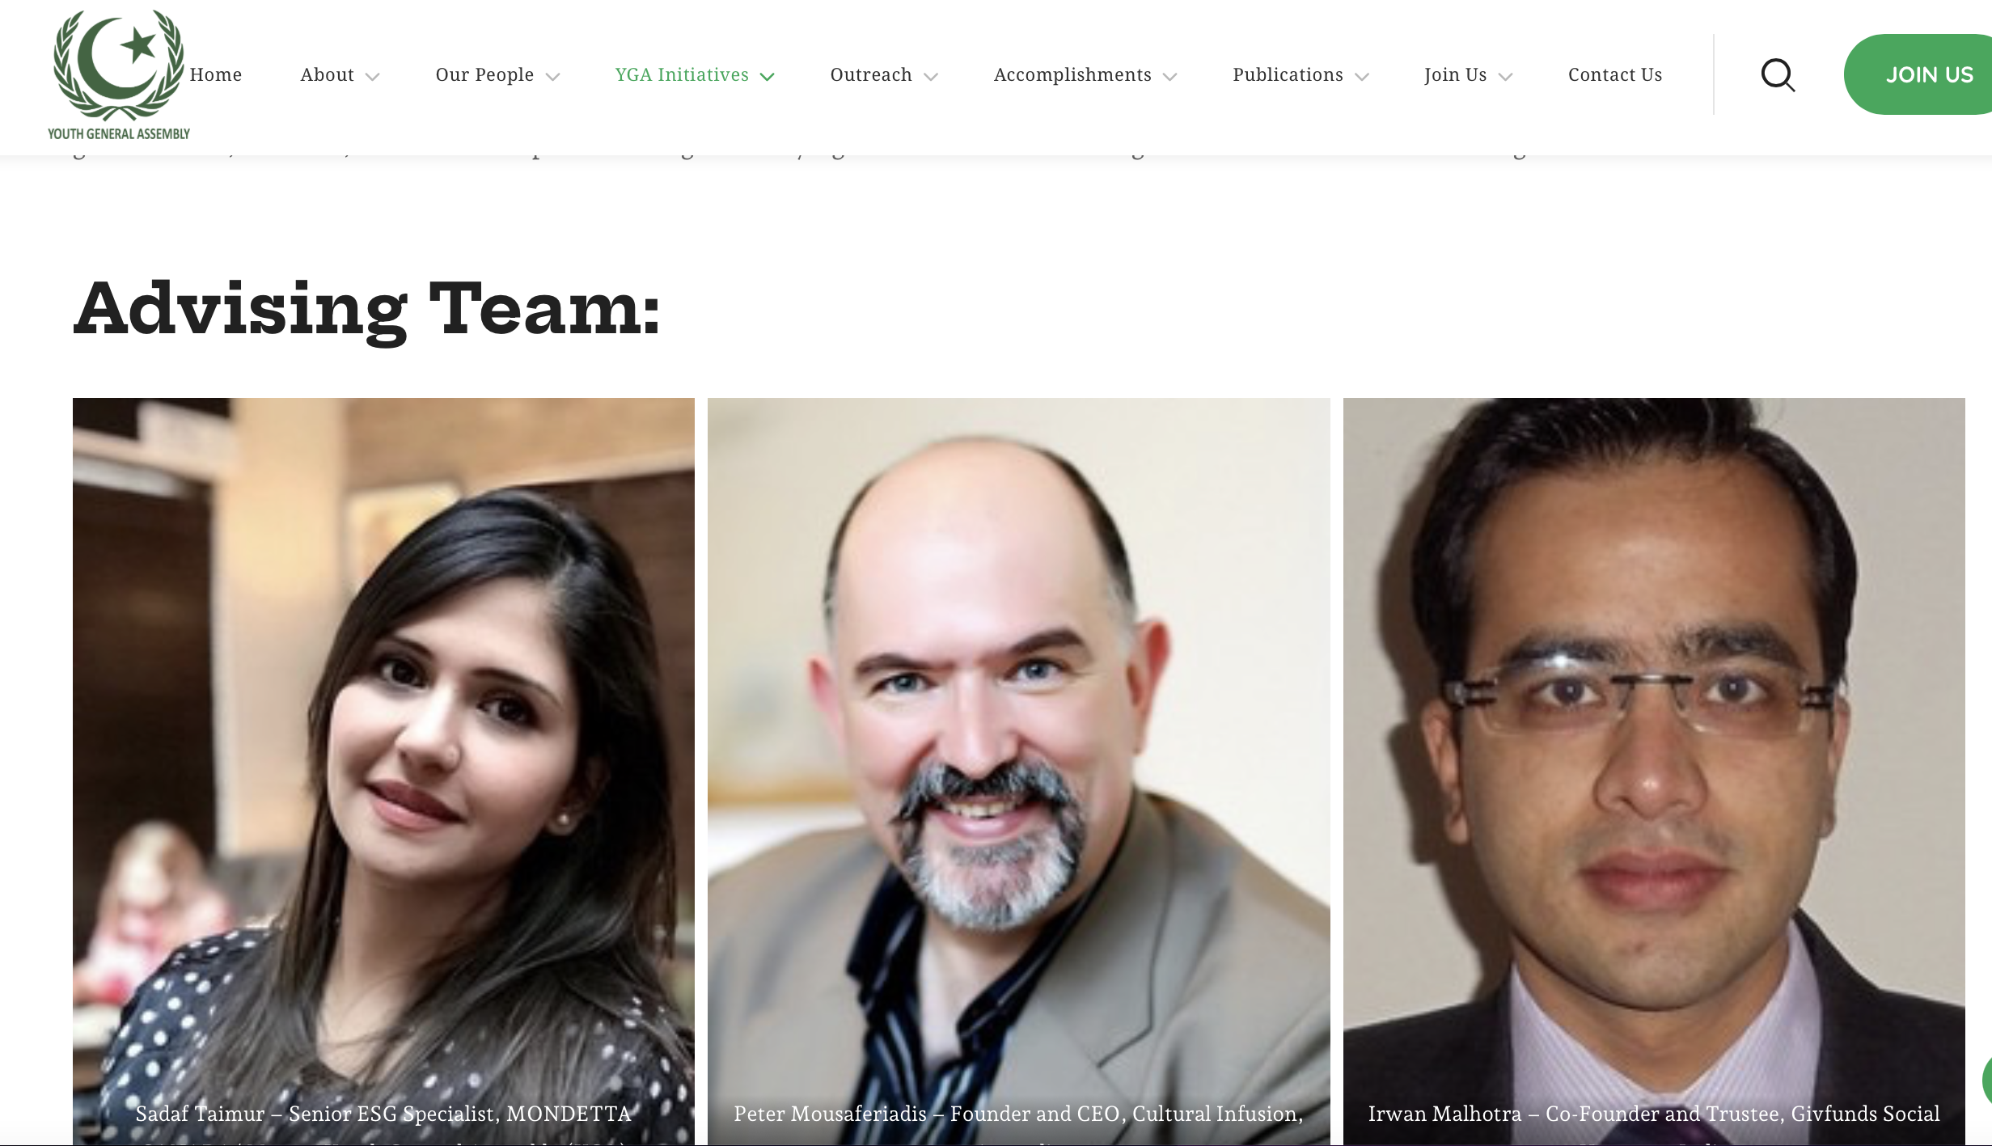
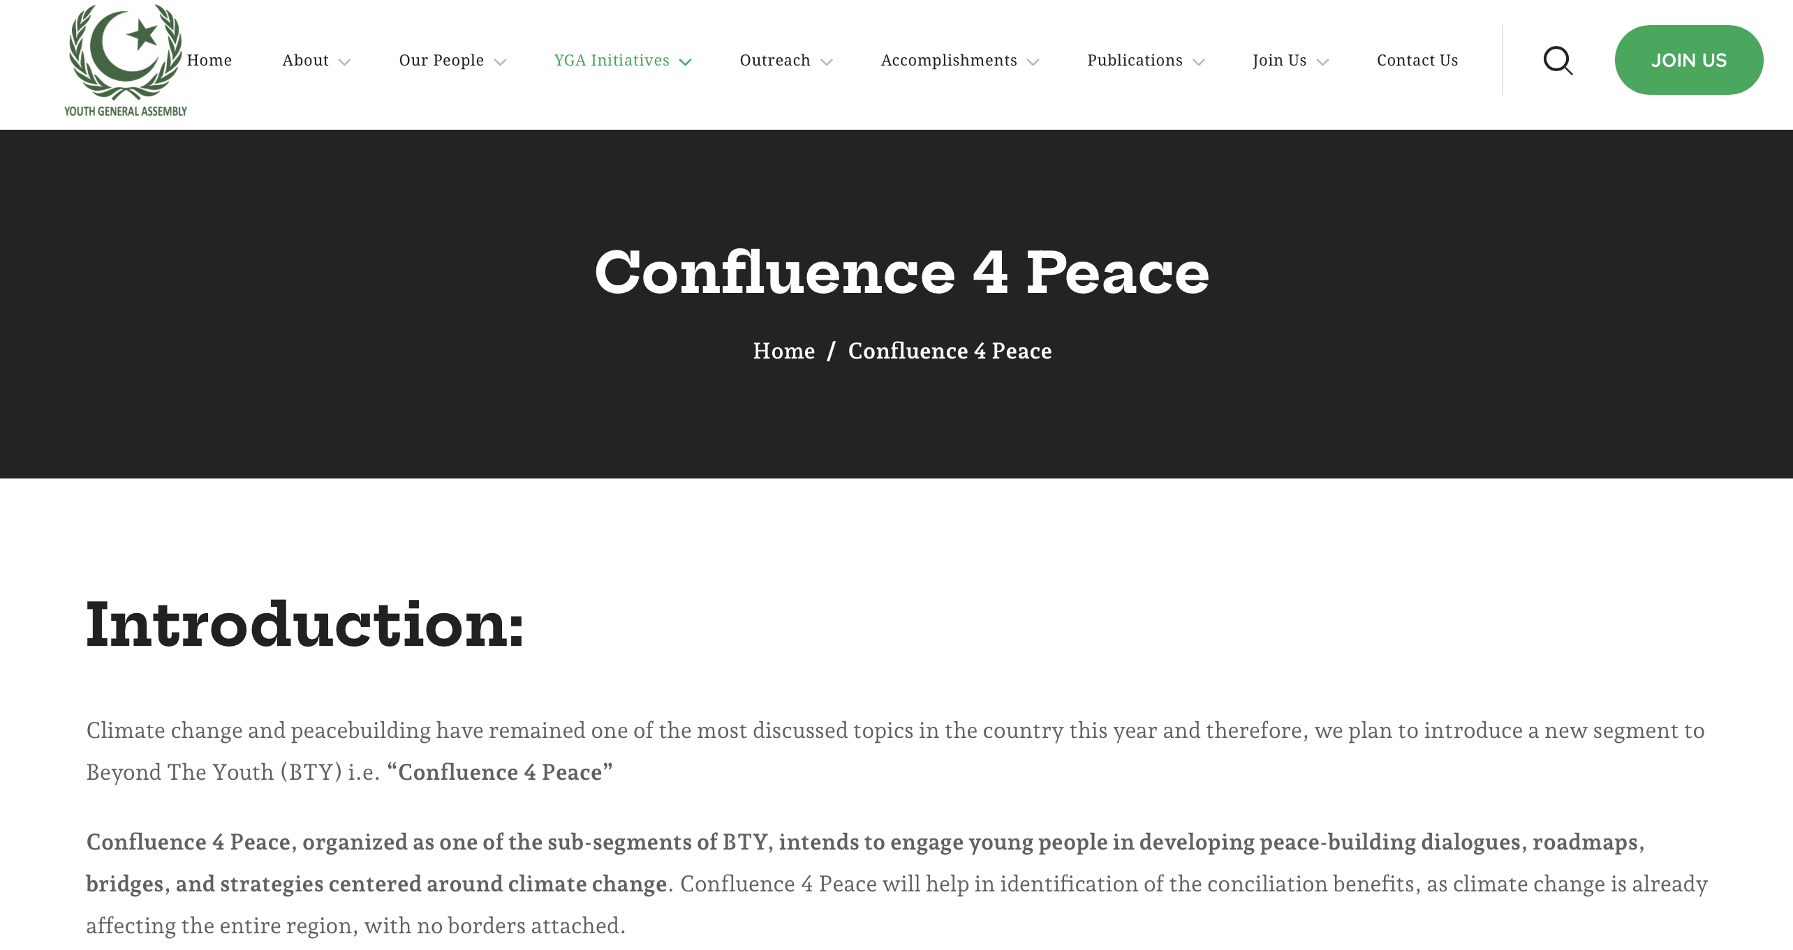
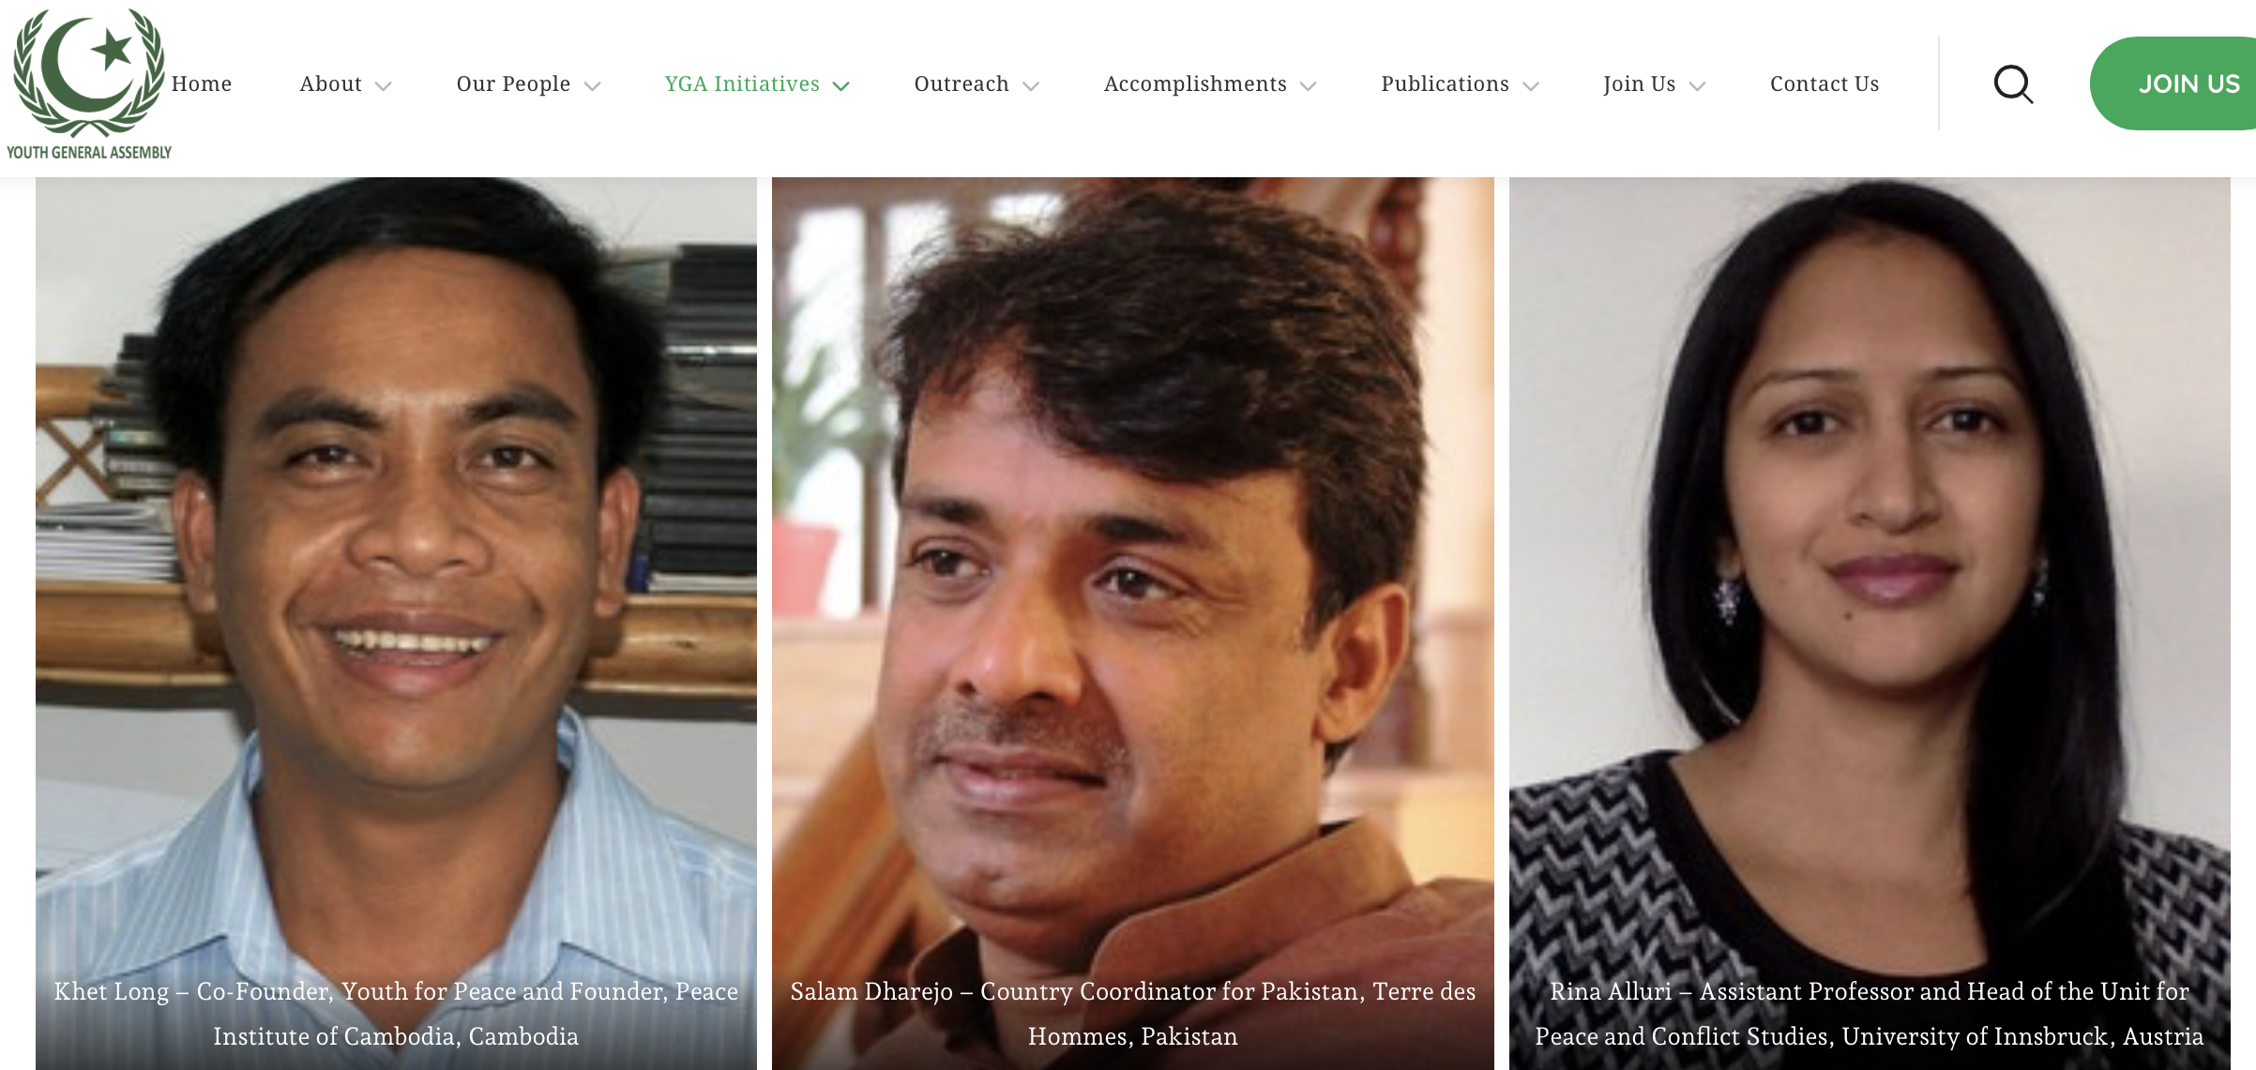
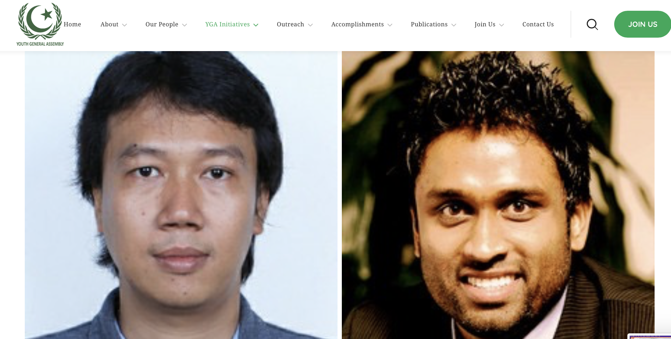
Website
https://ygapakistan.org/confluence-4-peace

Slide 15


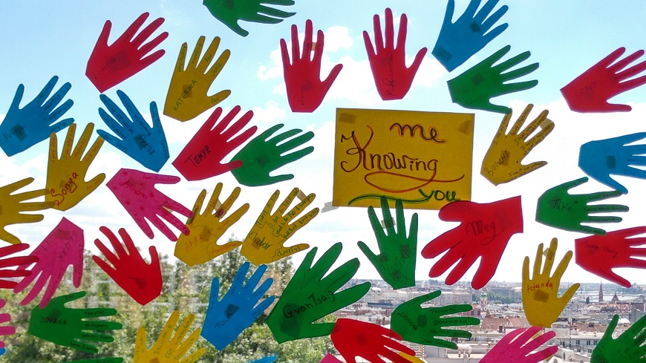

Implementation Mechanism
Virtual Counterparts
Action points & Insights About Future
Action points & Policy briefs
Politicians
Recruit & Train
Prepare & Implement
Youth Leaders
Prepare & Implement
Local Partner/Team
Confluence 4 Peace

Slide 16
Impact & Outcomes
Goal | Metric | Indicators
Exchanging Knowledge & Perspectives | Awareness & Perspective Exchange | The of knowledge on climate induced conflicts, the urgency of the issue Exchange of perspective aligned to each activity
Dissemination - Grassroots | Engagement & Intentions to Disseminate | Number of benificiaries highlighted in the dissemination pledge form Number of participants showing commitment to the cause Number of participants engaging
Policy Implications | Initiative Drive Policy Conversations | Number of policy reccommendations Perception of engaged/invited politicians

Slide 17
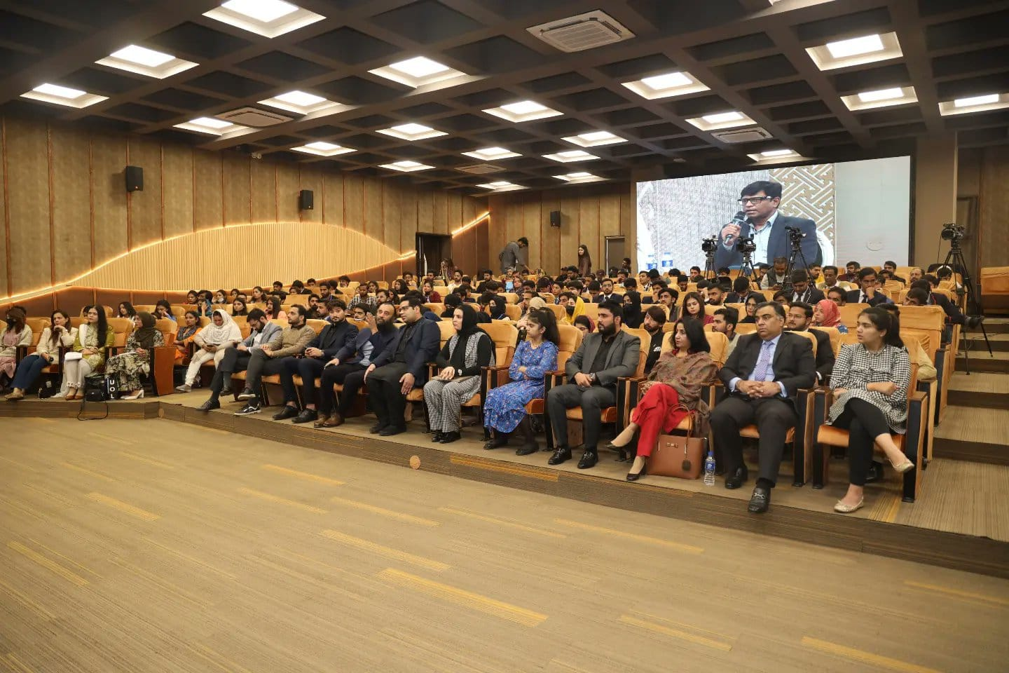
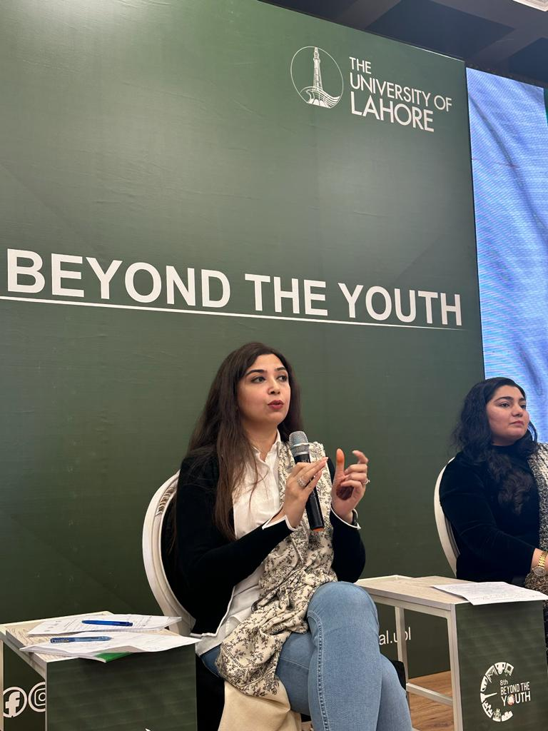
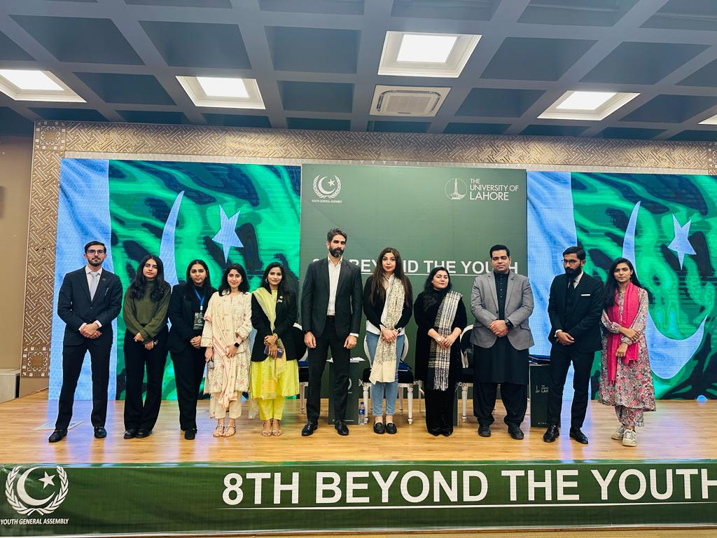
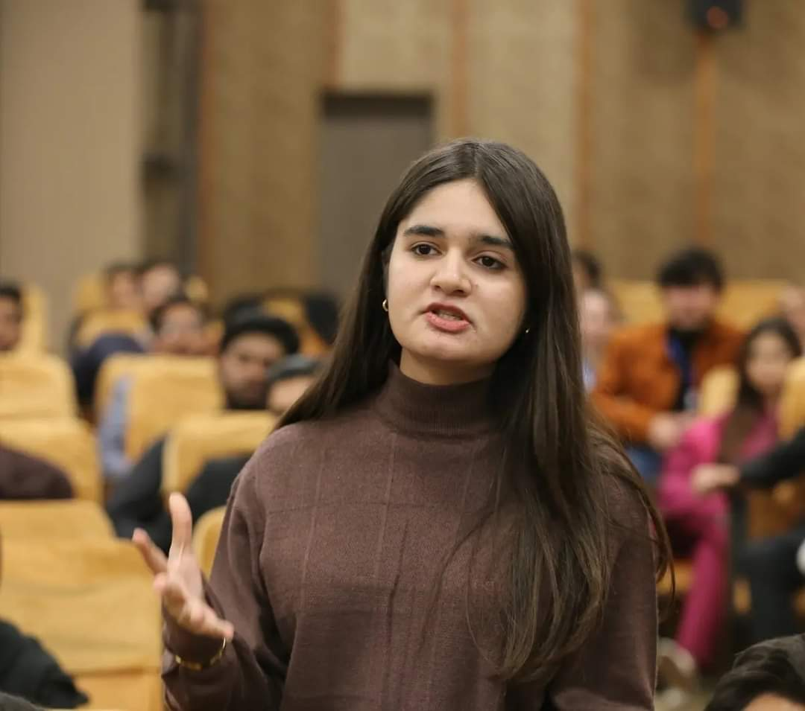
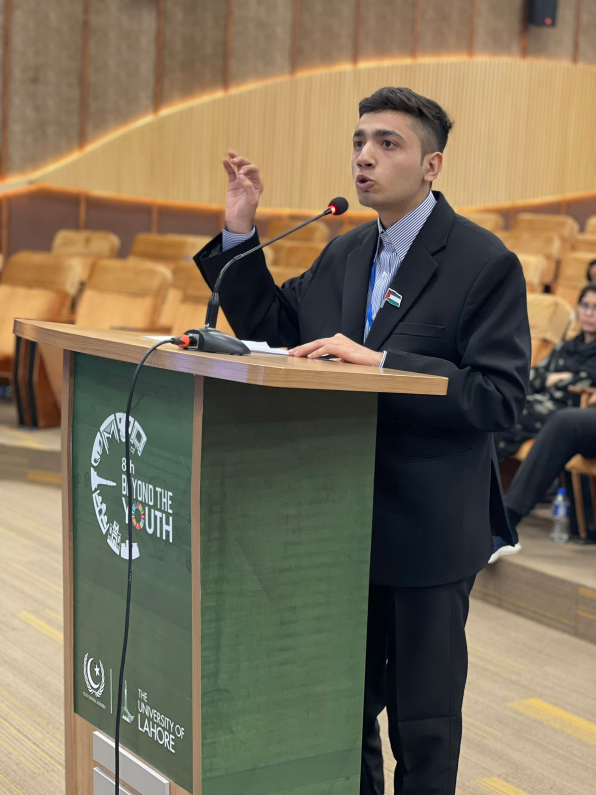
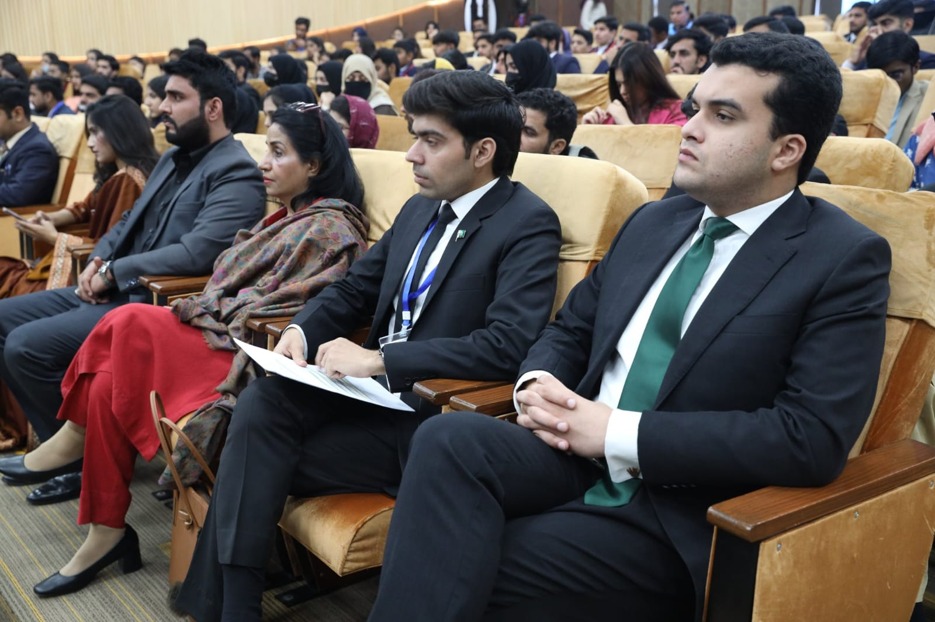
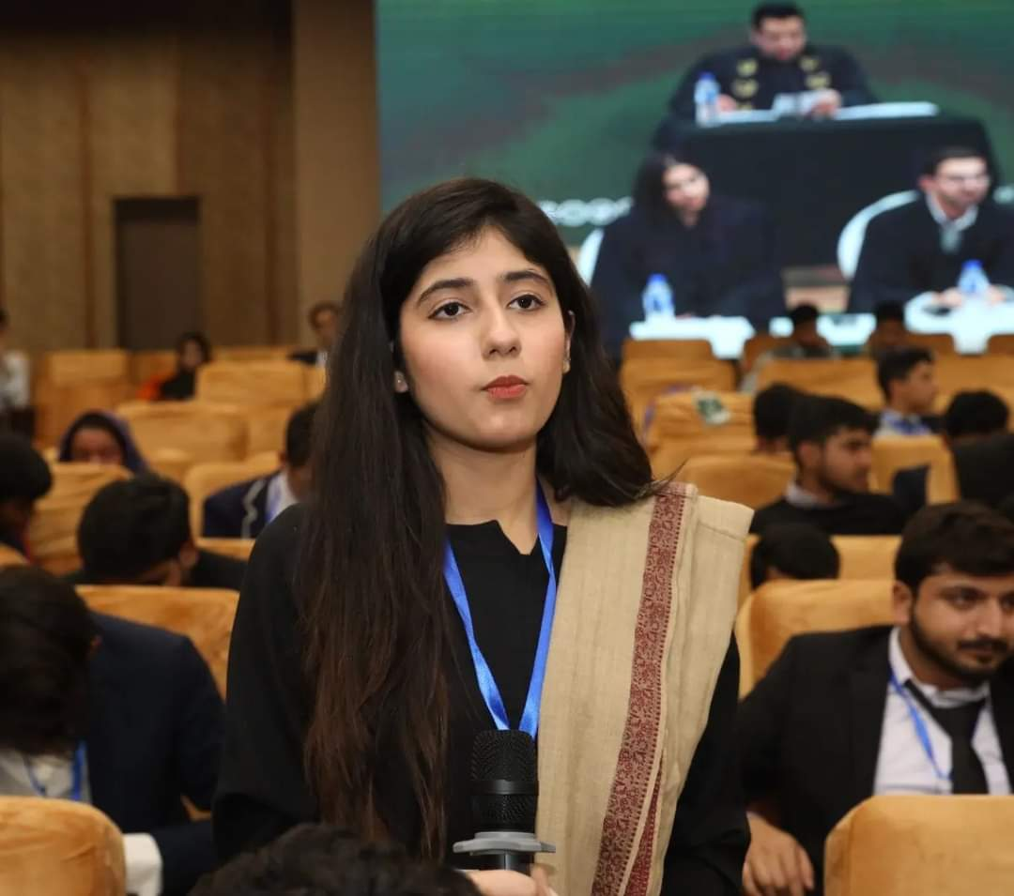
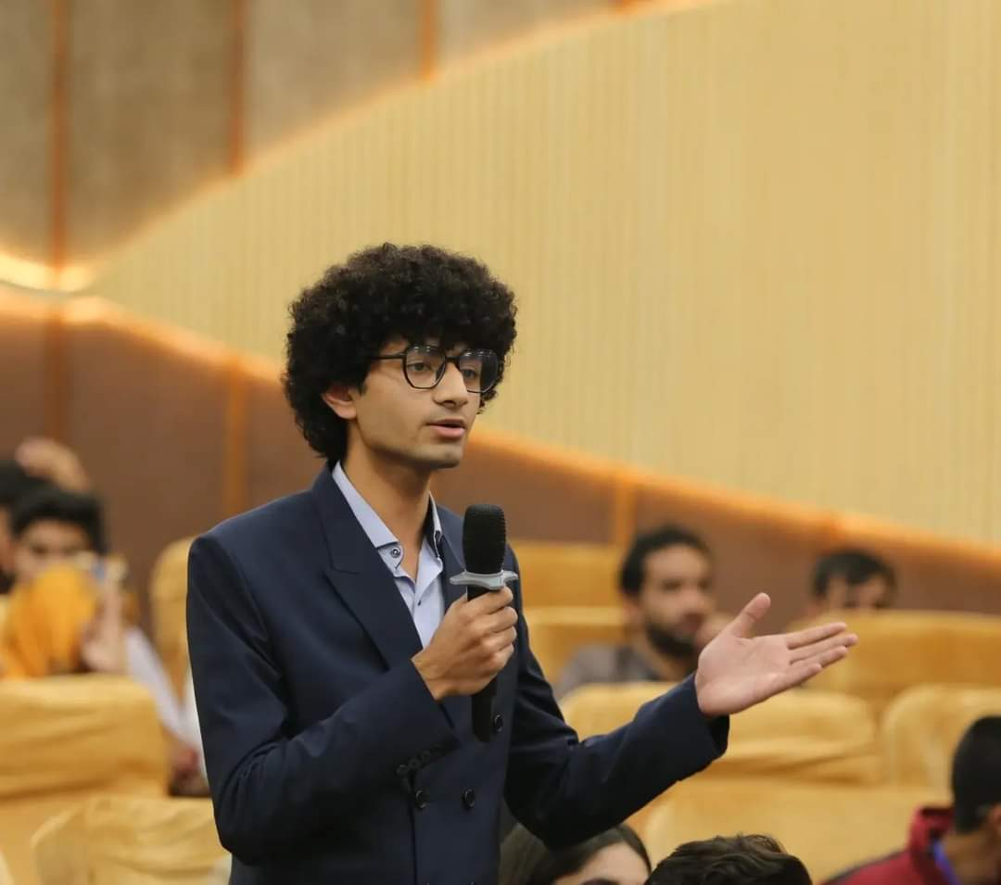
Highlights from the event
224 Participants

Slide 18
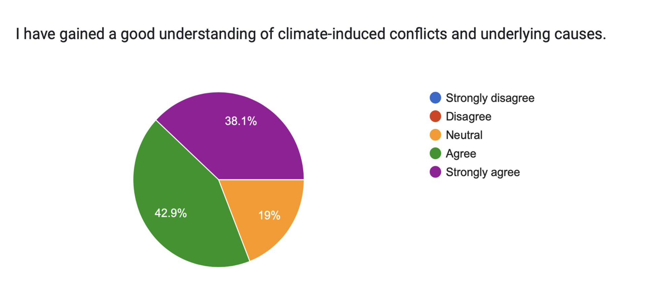
Impact

Slide 19
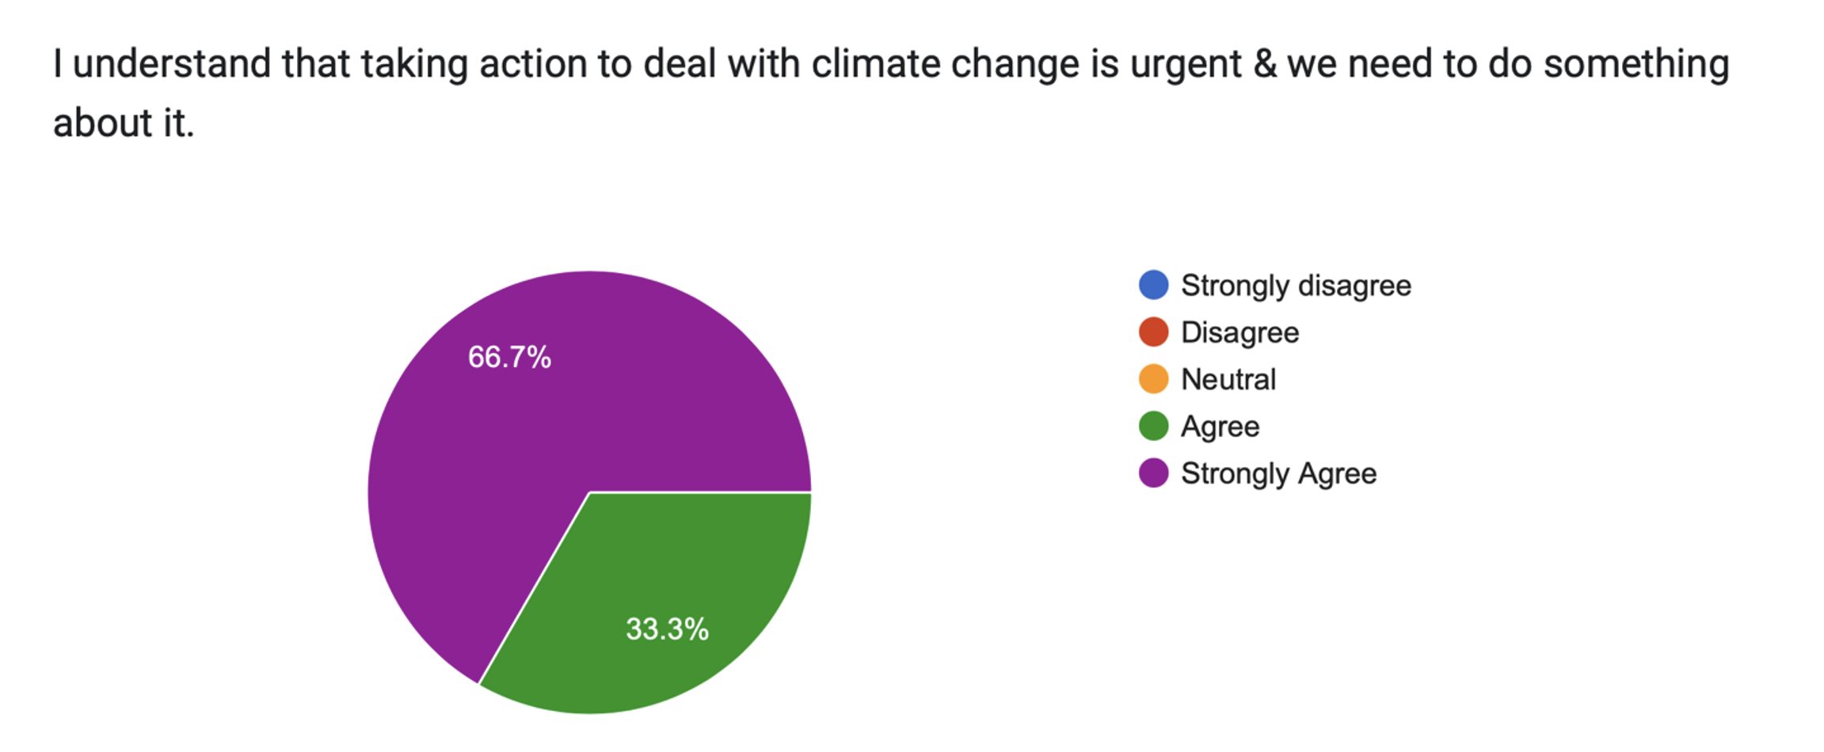
Impact

Slide 20
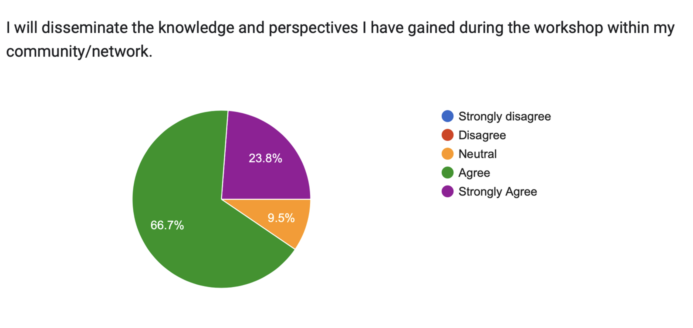
Impact

Slide 21
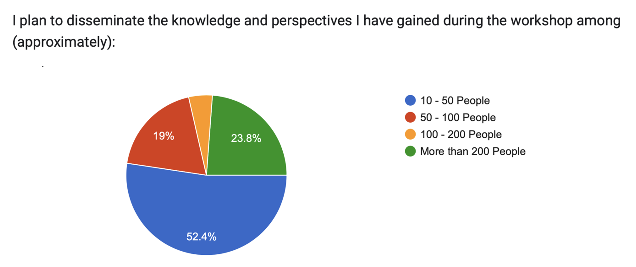
Impact

Slide 22
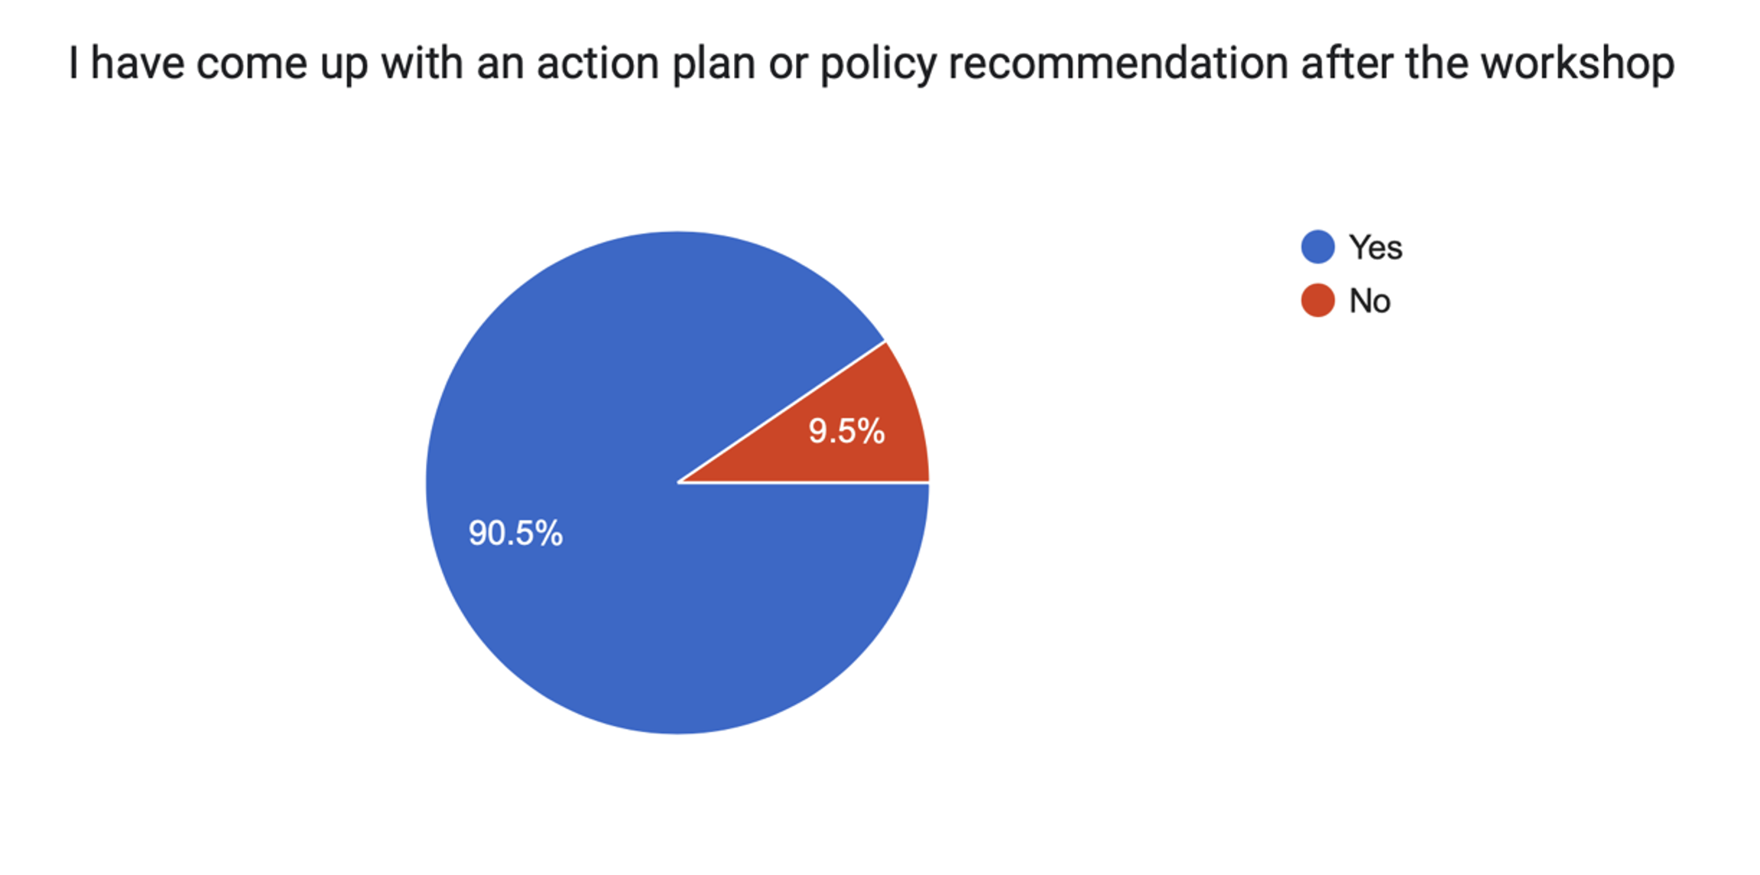
Impact

Slide 23
Beneficiaries
200+ Young People
45+ Young Alumni
32+ Politicians
20+ Youth Counterparts
14,000+ Community Members

Slide 24
Scaling & Sustainability
Confluence 4 Peace as a Sub-Segment of BTY
Uploading the toolkit and impact report on the website – to gain visibility & scale
Toolkit –easy to tailor and scale
Partner with new counterpart every year - scale

Slide 25
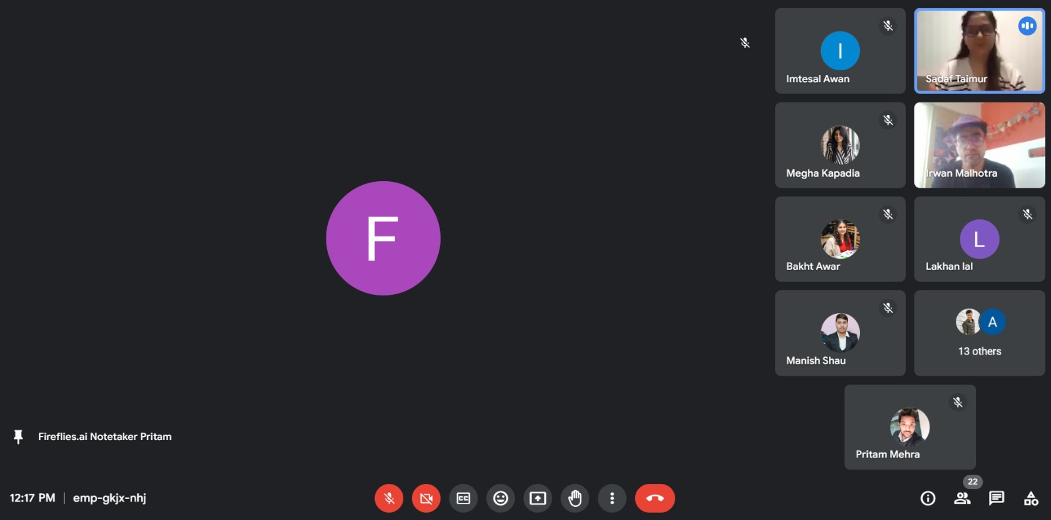
Scaling & Sustainability
Exchange Event in India
Pilot in Nepal

Slide 26
Action Points
Changing the Name
Established the concrete way forward with timeline
Define tentative themes/segments
Add new members to the team

Slide 27
Action Points
Change the name “SANGAM – Festival of Confluence” (Nepali, Urdu, Hindi, Bengali)
The importance of language and words we use and the meaning of those word across geographies.
The word peace can be seen as controversial and taking a negative peace approach rather than a positive or soft approach to peace.

Slide 28
Action Points
We were able to define a proposed structure of the program and a timeline.
  Concept note to Baburam and Subindra (by 15th April )
  They will come back to us with feedback once they’ve bounced it around with the young/held consultation (by 30th April)
  Aligning activities and budget to the research (by 15th May)
  A pitch deck will be developed (by 30th May)
  Meet with partners again(15th June)
  Extended proposal (based on the meeting)
  Event to be held between Sept-Oct, 2024

Slide 29
Action Points
We were able to define the tentative program themes/segments
  Forums – which would include speakers featured according to the themes
  The role of interfaith in addressing climate challenges & Sustainability issues
  Exploring confluence through architecture
  Exploring confluence through music
  Leading environmental activists who can talk about the river systems/key areas
  Cross Cultural Arts Initiatives/Musicians coming together from different regions/ Artists collaborating on to address the theme – mural, exhibition /Dance and spoken word
  Community Engagement/ Plogging – sport of litter collection/Tree planting

Slide 30
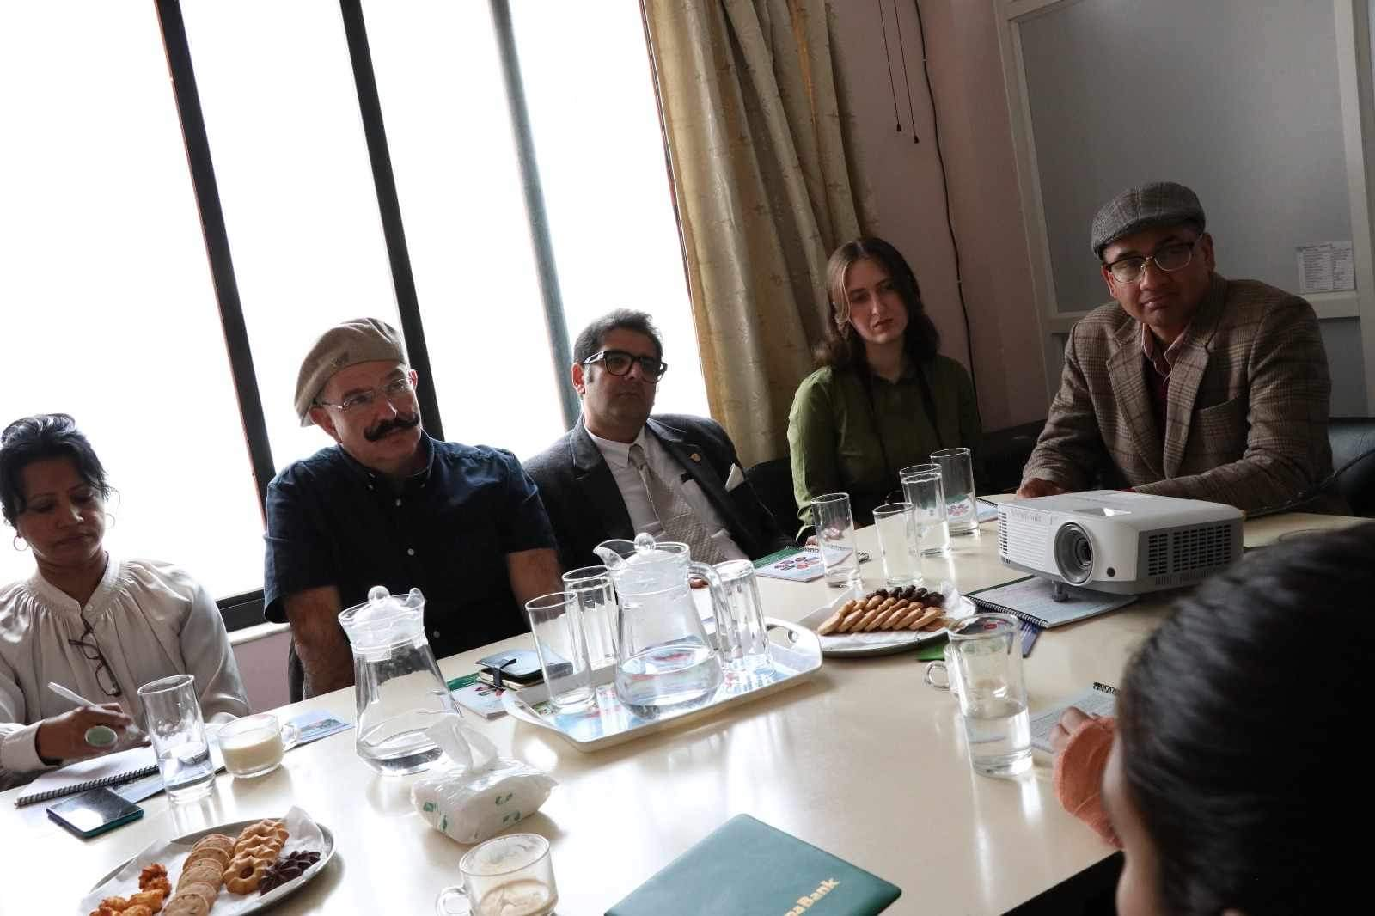
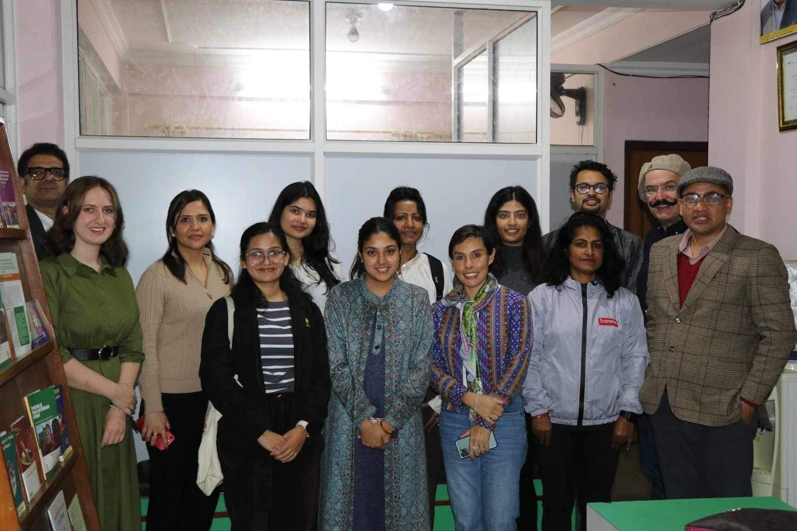
Action Points
We were able to meet ”Young Network for Climate Action” in Nepal
  Verbal confirmation to incorporate the festival in the Yearly conference “National Youth Climate Change Conference” (NYCCC)
  We have set the timeline for the next meeting with them (April 20, 2024)

Slide 31
Action Points
We were able to get new team members on-board
  Navras
  Subindra
  Annu

Slide 32

Future generations are the key to a sustainable planet.
If we offer them a chance.
Help us build a path towards peace by solving major climate-related problems.
Support Confluence 4 Peace!

Slide 33

Thanks!

