Slide 1




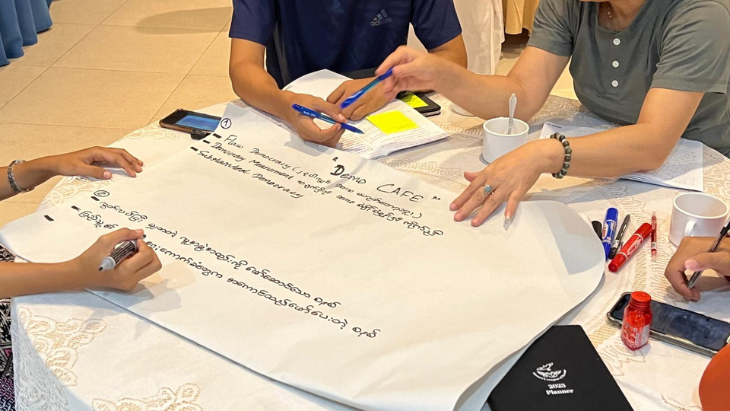

DATE:
MAY 10, 2025
PRESENTED BY:
PHONE, NISHA,HTU, KRMANJ
Reimagining-TJ
BEYOND THE COURT ROOM: GRASSROOTS PATHS TO HEALING AND JUSTICE

Slide 2





Problem
Statement
  TJ is relatively new to Asia
  TJ models are global North and Elite driven
1
3
Without integrating Asian perspectives and informal, community-based approaches, TJ mechanisms risk alienation, ineffectiveness, and further marginalization of victim communities.
unjustice in grassroot is still on-going
Unsuccessful stories
  Widespread impunity and Lack of accountability remain a challenge across Asia.
  lack of trust on formal accountability mechanisms
2
  Peace making
  Peace management
  Sustainable peace
Peace Process

Slide 3







Concept of Reimagining-Transactional Justice
concept
We propose a fundamentally different approach through “reimagining" transitional justice - a framework that deliberately shifts the focus from elite-driven, top-down processes to community-centered, grassroots mechanisms that operate at the local level.

Slide 4




Key Beneficiaries:
Stakeholders, including human rights activists, Victim advocates, members of justice sector
Internal TJ experts and victims from Sri Lanka, Myanmar and Iraq

Slide 5







What has already been tried? & Where does your idea fit into the landscape?
Formal Transitional Justice models: truth commissions, investigative panels
Sri Lanka, Myanmar, Iraq

Slide 6



Strengthening the solution & Testing feasibility
Alternative approaches to justice and accountability
micro-transitional Justice
Viable
Innovative
Scalable
  Data put together and comparative analysis
  Collective approach to capture informal practices on justice and healing
  Online
  Representation from Iraq, Sri Lanka, and Myanmar
  Small scale with existing resources
  Short term & pilot project

Slide 7








immediate STEP!
  NEXTWORK
  Resources map

Slide 8







Figure out
1
Communication: languages
2
Time differences
need of safeguarding measures as the topics could be controversial within local context
  IDEA FOR DESIGN
  TRANFERRENCE THE FINDINGS OUT TO BE USED BY RELAVANT STAKEHOLDERS
3
Barriers

Slide 9



ASK
NEXT STEP
Your recommendation
Share the materials & Opportunities
Experts, Stakeholders, Resources on Sri Lanka& Myanmar on TJ
Collaboration
Looking for fund
Collaboration with credible organizations for publication of the output ( ex: Asia Justice and Rights, Forum Asia, and Salzburg Global)
Create a brand strategy for external engagement
Expansion
Resources to expand to the other Asia countries
Expertise & Tools
Start collaboration with external stakeholders
Innovative approaches to publicize the findings

