Slide 1



Bridging
Indigenous
Norms for
Horticultural
Internationalization
BINHI

Slide 2









CLIMATE CHANGE
Food Security
lack of recognition and documentation of IP Norms
limited platform for exchange of good practices on agricultural system
Unsustainable food system

Slide 3










Strategies and Deliverable
PLANTING
GROWING
THRIVING
Mainstreamed IP Norms
Localization to Globalization
Sustainable and Resilient Food System
Research
Interreigonal exchange of good practices
Knowldege exchange
Reporting and Analysis
Community Engagement
Capacity enhancement
Stakeholder Involvement
Documentation of IP Norms

Slide 4



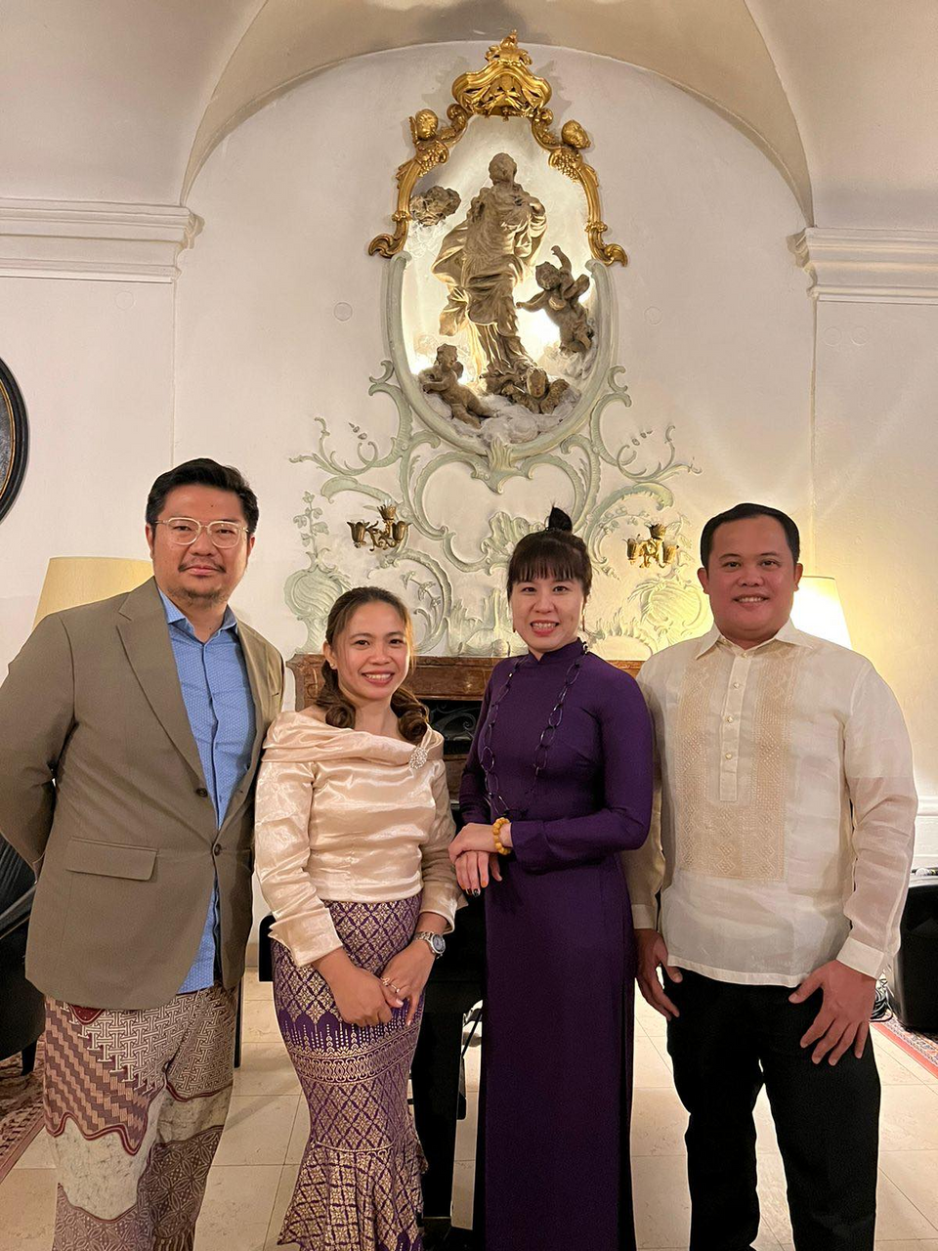
Our Team
Jerome Bactol
Robert Budianto
Nga Nguyen Hong
Ma. Erlinda Vila

