Slide 1

B I N H I
Bridging Indigenous Norms for Horticultural Internationalization
Notes:
ALLOW ME TO PRESENT ON BEHALF OF MY TEAM THE UPDATES ON BINHI PROJECT SINCE ITS CONCEPTUALIZATION IN MAY 2024 DURING THE ASIA PEACE INNOVATORS FORUM IN SALZBURG AUSTRIA.
OUR TEAM IS COMPOSED OF JEROME BACTOL, ROBERT BUDIANTO, NGA NGUYEN HONG & MA. ERLINDA VILA. OUR MENTOR IS DR. RABHI ABDESSALEM WHOM WE OWE THE SOLIDIFICATION OF OUR GOALS, OBJECTIVES AND MILESTONES , NOT ONLY FOR THE BINHI PROJECT BUT ALSO FOR OUR PARTICIPATION TO THIS PROJECT ACCELERATOR PROGRAM

Slide 2
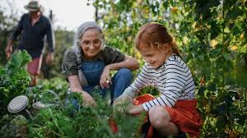
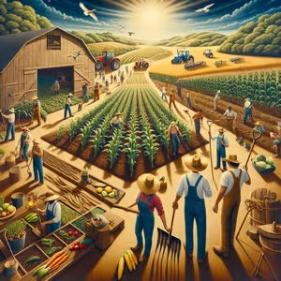

Slide 3
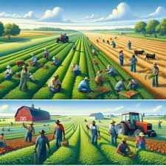
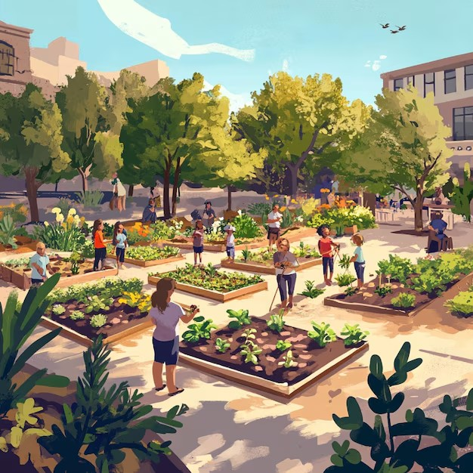

Slide 4

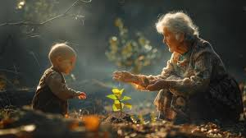

Slide 5
WE DON’T NEED TO IMAGINE

Slide 6
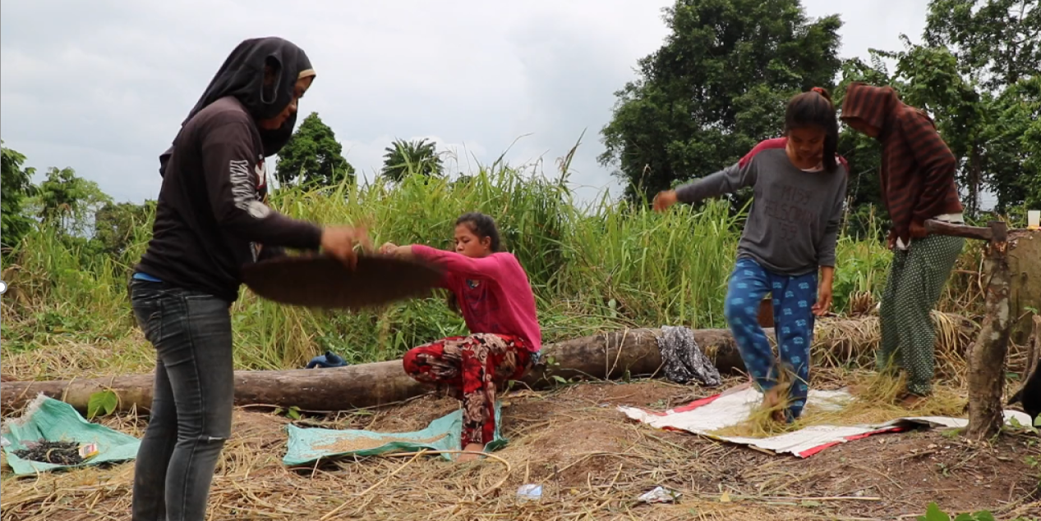

Slide 7
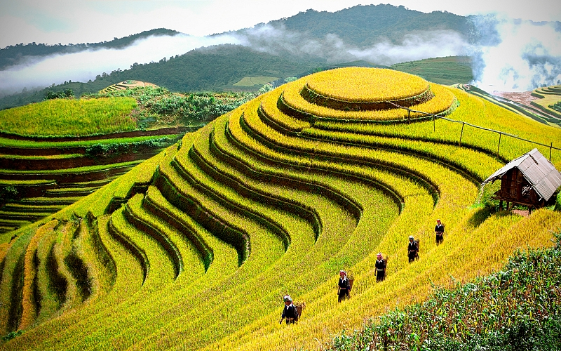
RUỘNG BẬC THANG IN VIETNAM

Slide 8
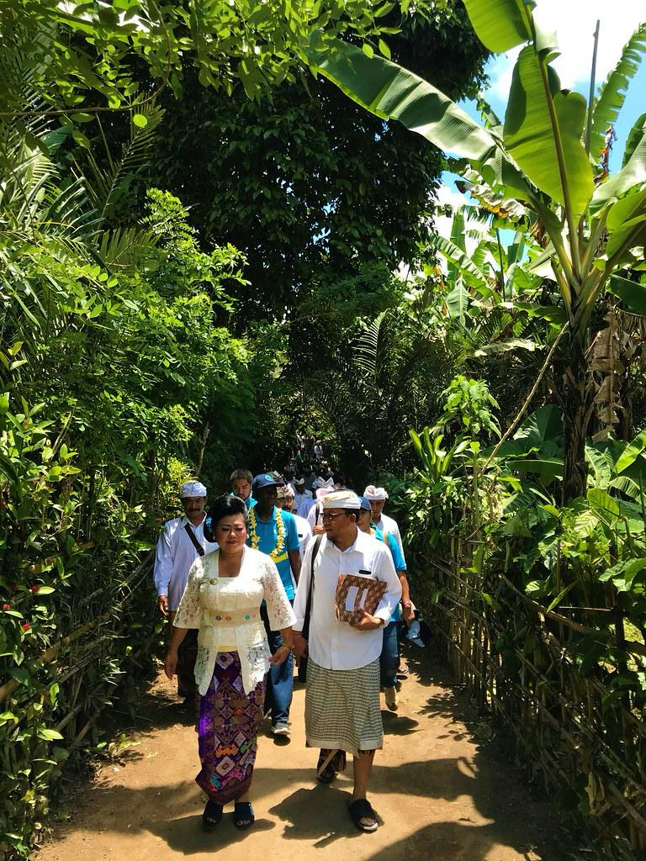
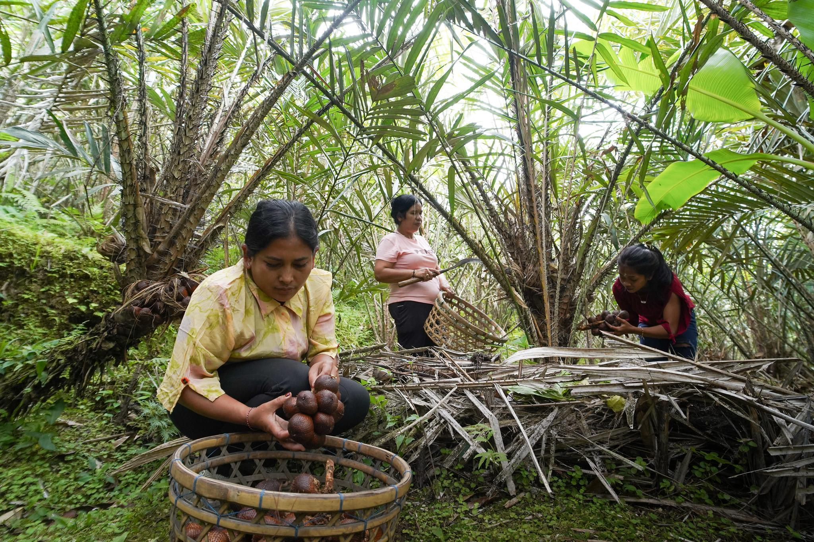
SALAK AGROFORESTRY SYSTEM IN INDONESIA

Slide 9
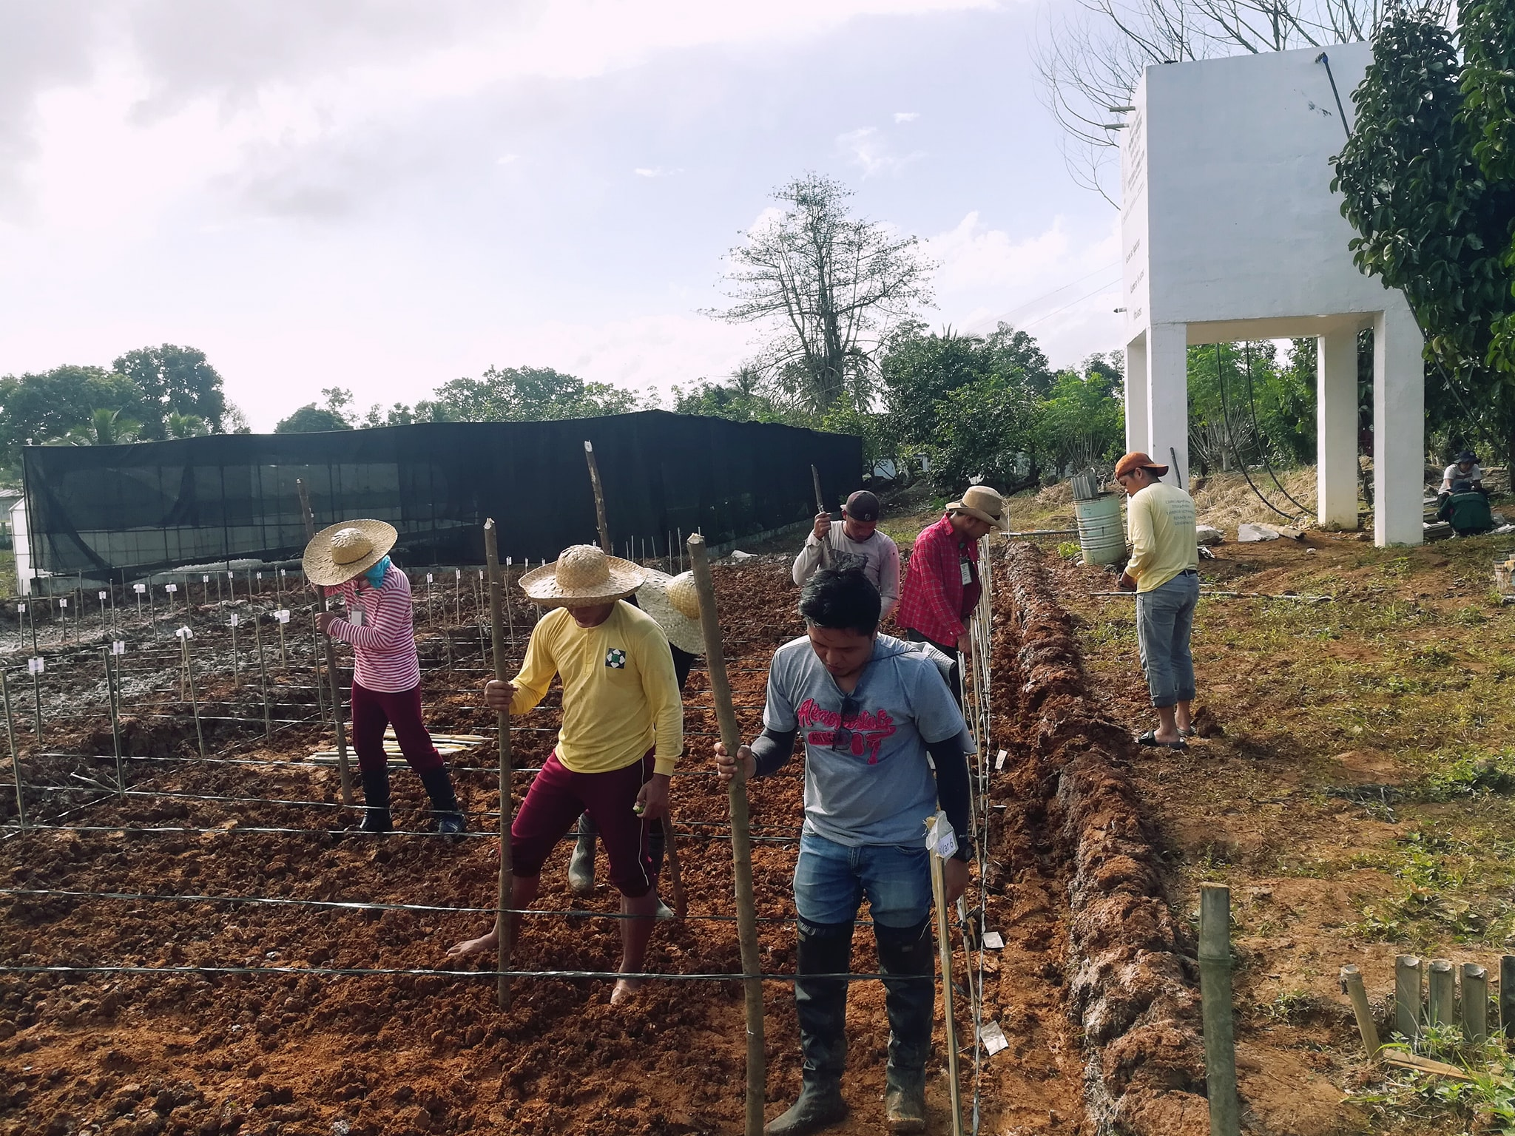
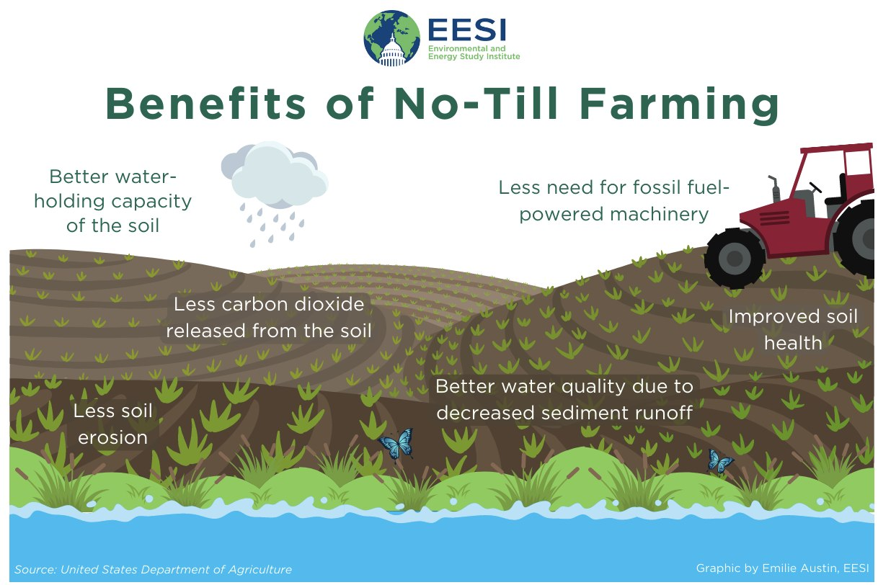
TUDAK/PUAY PLANTING METHOD IN THE PHILIPPINES
Notes:
Tudak/Puay Planting Method (Zero-Tillage Farming) in the Philippines
The Tudak or Puay planting method is a traditional zero-tillage farming technique used in the Cordillera region of the Philippines, particularly by indigenous farming communities. It is a sustainable and labor-efficient way of growing crops, particularly rice and corn, in mountainous and sloped areas.
Key Features of the Tudak/Puay Method
No Plowing or Tilling of Soil
Unlike conventional farming, the soil is left undisturbed, preserving its natural structure and nutrients.
Use of a Dibble Stick (Tudak/Puay Stick)
Farmers use a pointed wooden tool (dibble stick) to make holes in the soil, where seeds are directly planted. This eliminates the need for plowing.
Preservation of Soil Fertility
Since the soil is not disturbed, organic matter from decomposed plants remains intact, enriching the land naturally.
Erosion Control
This method is ideal for hilly or sloped terrains, as it prevents excessive soil erosion compared to conventional plowing.
Water Conservation
Since the topsoil remains covered with plant residues, it retains more moisture, making it suitable for rain-fed farming.
Weed and Pest Management
Natural vegetation cover helps suppress weeds and encourages beneficial organisms that control pests.
Crops Grown Using Zero-Tillage in the Philippines
Rice (Upland Varieties)
Corn
Root Crops (e.g., sweet potatoes, cassava)
Legumes (e.g., mung beans, peanuts)
Advantages of Tudak/Puay Farming
✔ Sustainable and environmentally friendly
✔ Reduces labor and costs (no need for plowing or excessive weeding)
✔ Improves soil fertility and biodiversity
✔ Prevents land degradation and soil erosion
Challenges
Slower seed germination in compacted soil
Dependency on favorable rainfall patterns
More initial manual labor required for planting
This traditional zero-tillage method remains significant today, especially in promoting sustainable agriculture in upland communities. It aligns with modern conservation agriculture practices, making it an eco-friendly alternative to conventional plowing.

Slide 10
But today,
these practices are
at risk of disappearing

Slide 11
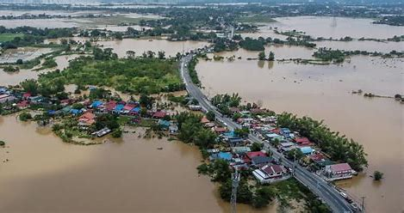

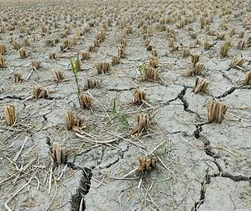

Slide 12
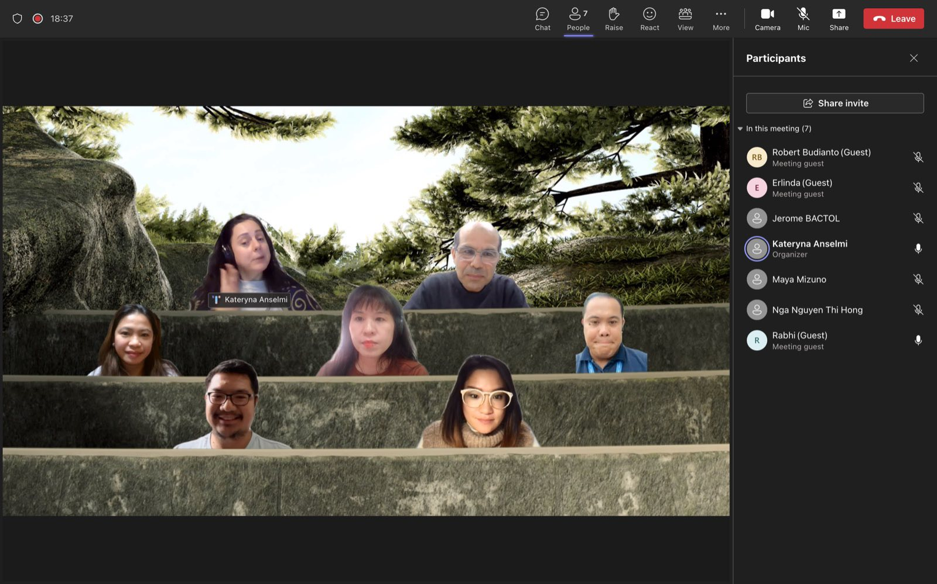
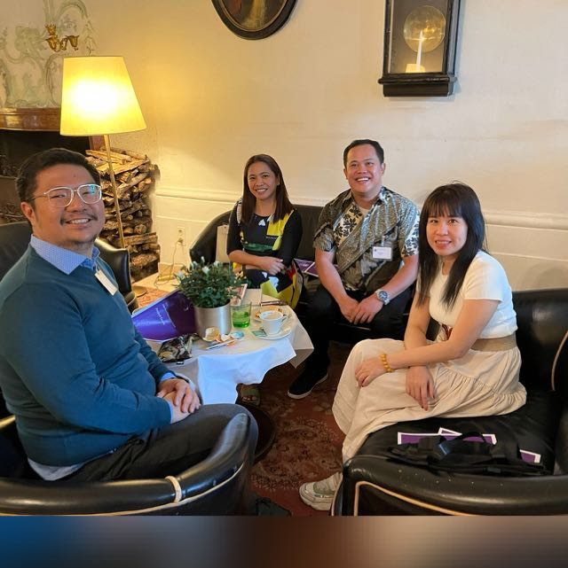
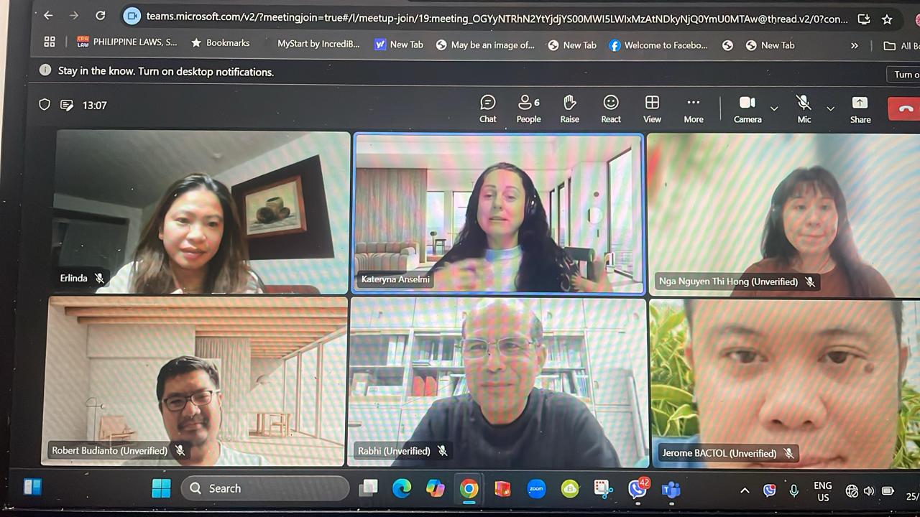
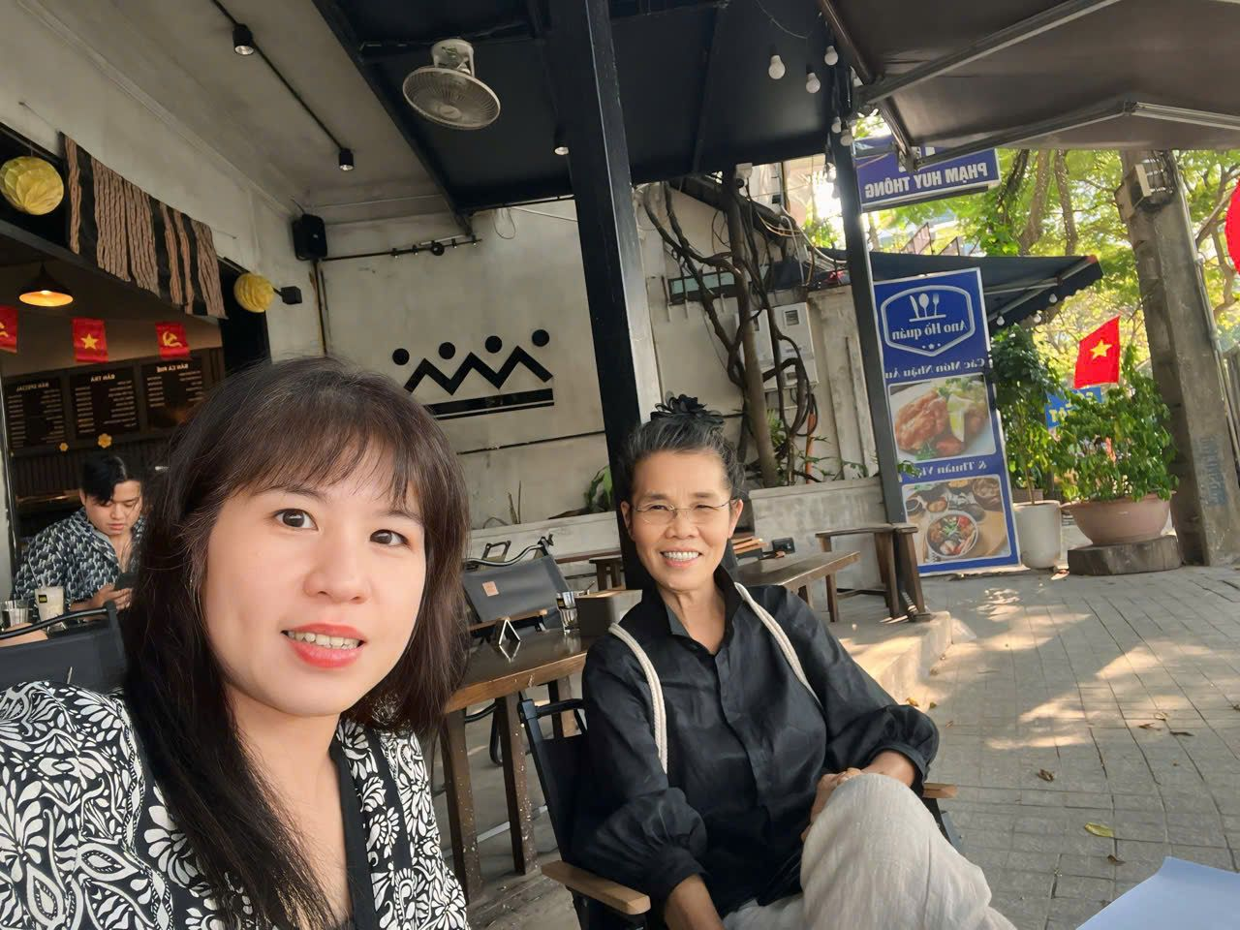
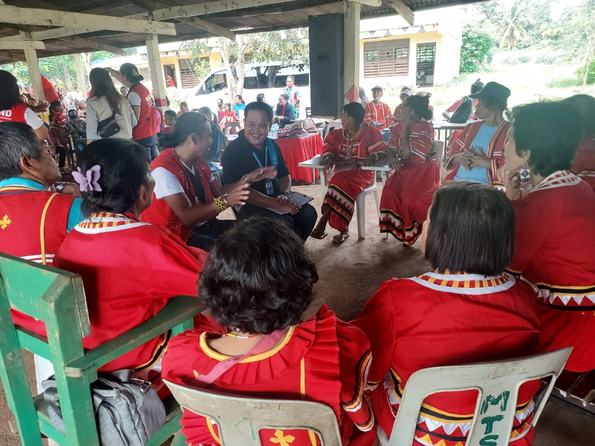
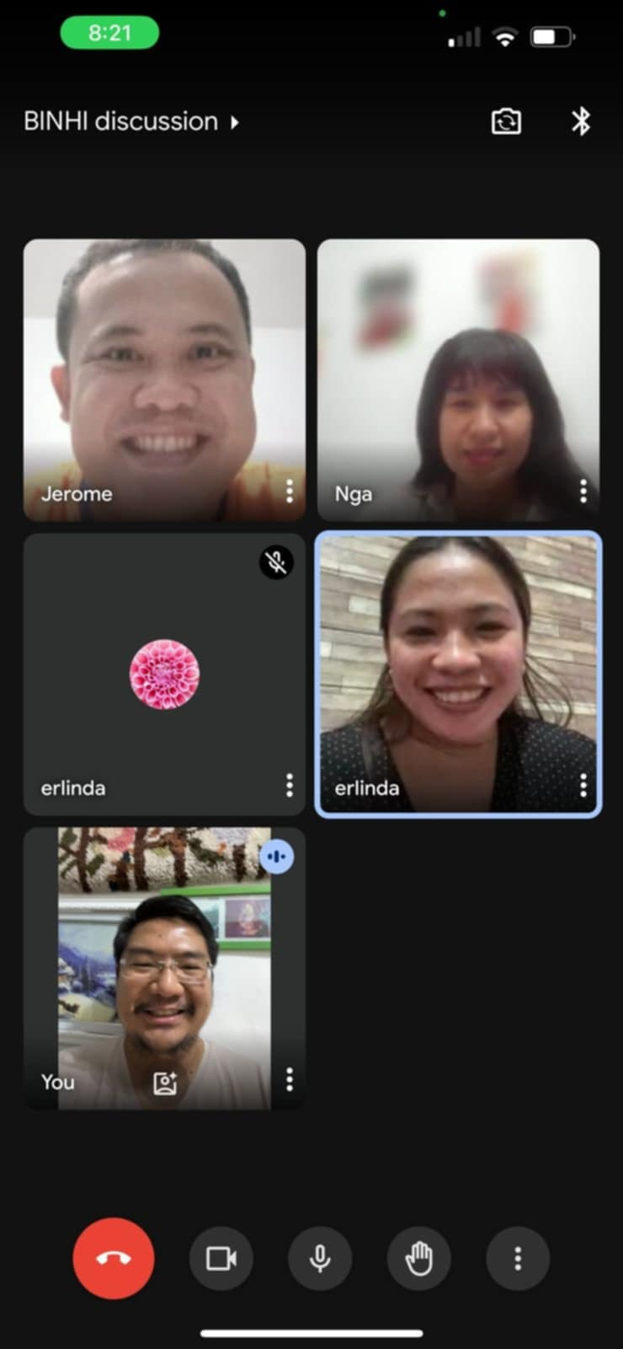
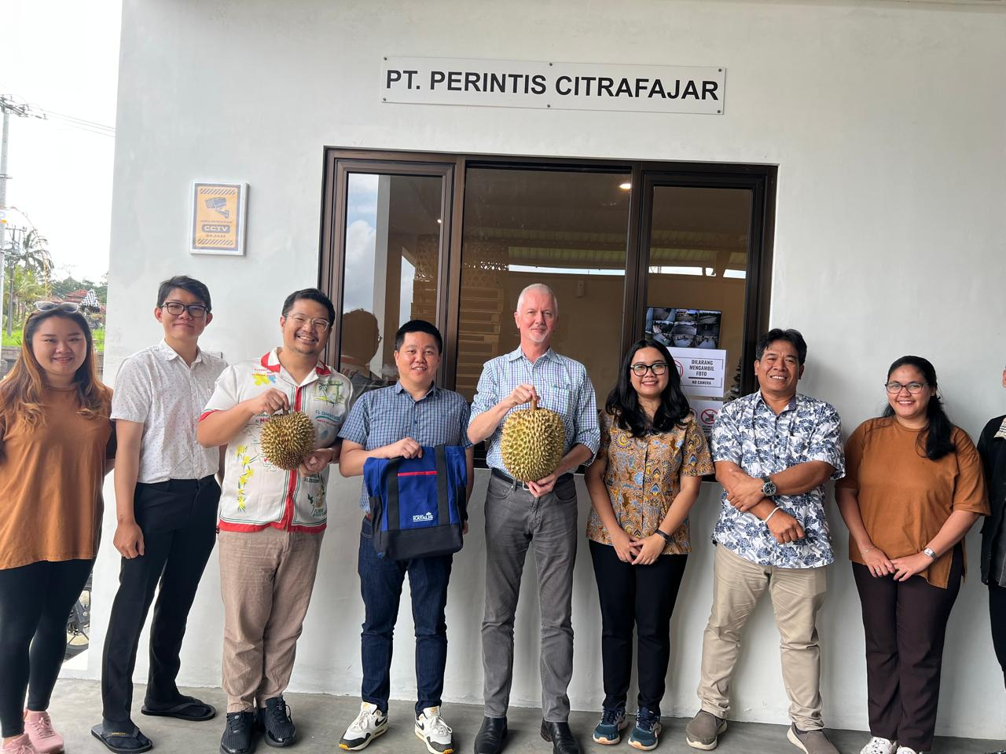
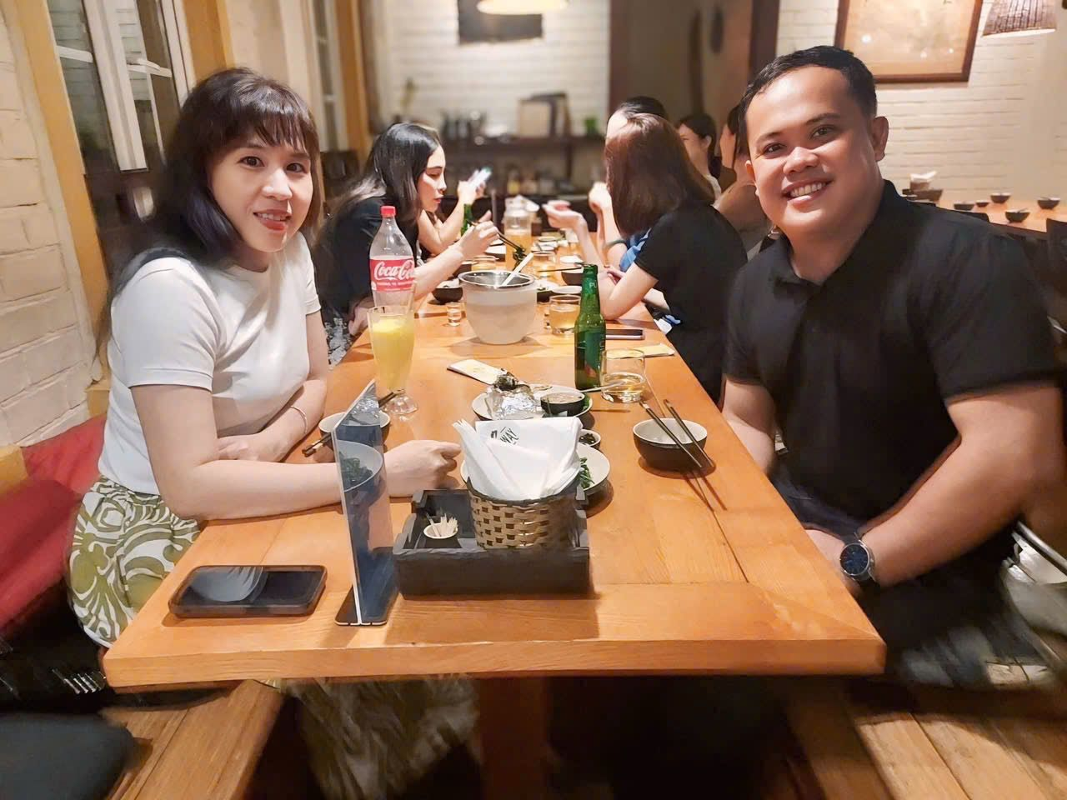
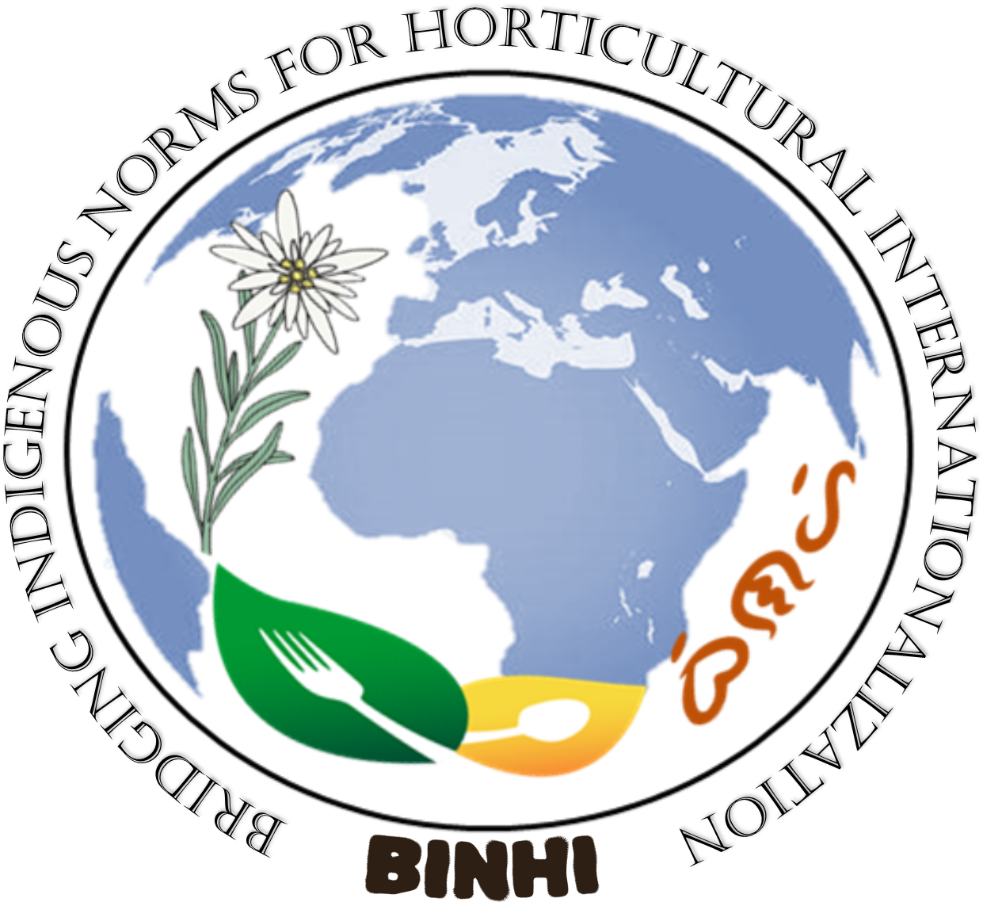
Notes:
AND THAT ENDS MY PRESENTATION, THANK YOU AND MAY WE ALL HAVE PRODUCTIVE SESSIONS IN THE NEXT DAYS TO COME.

Slide 13
Bridging Indigenous Norms for Horticultural Internationalization (BINHI)
The BINHI Project focuses on addressing the lack of recognition and documentation of Indigenous Peoples' (IP) norms in agricultural systems, which is crucial for climate change adaptation and food security.
The project aims to mainstream IP norms and facilitate the exchange of good agricultural practices through interregional collaboration, fostering a sustainable and resilient food system. Key approaches include research, community engagement, stakeholder involvement, and capacity enhancement.
By documenting IP norms and promoting knowledge exchange from local to global levels, the project seeks to build a robust platform for sustainable agriculture, ultimately enhancing food security and resilience against climate change.
The anticipated outcomes include better recognition of IP norms, improved agricultural practices, and strengthened food systems that can thrive in the face of environmental challenges.

Slide 14




“We plant BINHI to remember our roots”
2024
“In BINHI, we cultivate indigenous wisdom for a sustainable tomorrow”
“We grow BINHI to share and preserve our practices”
2024
2025
“BINHI will thrive to bridge tradition and innovation”
2026
Notes:
MAY OF LAST YEAR, WE PRESENTED OUR ROADMAP OF OUR REALIZATION OF THE BINHI PROJECT BY 2026. AS WE HAVE CONCEPTUALIZED, BINHI IS TO BE PLANTED TO DOCUMENT INDIGENOUS AGRICULTURAL NORMS, GROW THEM TO IMPROVE AGRICULTURAL PRACTICES, THEREBY THRIVING TO PROMOTE STABLE SOCIETIES CAPABLE OF WITHSTANDING THE CHALLENGES RELATED TO THE NEXUS OF FOOD SECURITY AND CLIMATE CHANGE. AND THAT BINHI WILL BE CONTINOUSLY CULTIVATED UNTIL THE LOCAL PRACTICES BECOME GLOBALLY RECOGNIZED.
*****CLICK*****
HENCE OUR ACCOMPLISHMENT FROM MAY TO DECEMBER 2024 INCLUDES: IN AUG 2024 WE TOOK THE CHALLENGE AND APPLIED FOR THE PROJECT ACCELERATOR PROGRAM ; FORTUNATELY, ON SEP 2024 WE RECEIVED THE GOOD NEWS THAT OUR TEAM IS PART OF THE ACCELERATOR PROGRAM; THUS IN NOV 2024, WE WERE INTRODUCED TO OUR MENTOR, DR. RAHBI AND AT THE SAME TIME WE PRESENTED THE BINHI PROJECT; AND, IN DEC 2024, WE HAD A BRAINSTORMING TO IMPROVE OUR PROPOSAL BASED ON DR. RAHBI’S RECOMMENDATIONS.
THOUGH NOT MUCH, WE ARE PROUD THAT FROM AN INITIAL BRAINSTORMING IDEA IN SALZBURG IN MAY 2024, OUR PROJECT SOLIDIFIED WITH CLEAR GOALS, OBJECTIVES AND MILESTONES BY THE END OF 2024 WITH THE SUPPORT OF SGS TEAM. THOUGH WE ARE GEOGRAPHICALLY CHALLENGED, OUR MOTIVATION FOR THIS PROJECT ENABLED US TO WORK IN OUR OWN SPACE TO IDENTIFY POSSIBLE COLLABORATORS AND PARTNERS ON THE GROUND AS WE ENVISION TO TAKE THIS PROJECT FORWARD. OUR CONVERSATION WITH OUR MENTOR IS A GREAT STEP SINCE HE WAS ABLE TO HELP US IDENTIFY THE GAPS AND POSSIBLE AREAS WE WILL WORK WITH IN THE ACCELERATOR WORKSHOP. SO IN SUMMARY, IT MAY BE CLICHE BUT OUR GREATEST ACCOMPLISHMENT SO FAR IS TO BUILD THE TEAM AND ANCHOR OUR VISION TOWARDS BINHI. THIS WILL NOT BE POSSIBLE WITHOUT THE SALZBURG GLOBAL.
*****CLICK*****
THEREFORE AS WE MOVE TOWARD GROWING “BINHI” THIS YEAR, WE ARE ENVISIONING THAT THROUGH OUR WORKSHOP, OUR TEAM WILL BE ABLE TO:
BUILD A SOLID FOUNDATION FOR THE PROJECT REGARDING TOOLS, METHODOLOGY, AND RESOURCES TO ENSURE SUSTAINED IMPLEMENTATION ONCE WE ENGAGE WITH THE COMMUNITIES ;
DEVELOP A DETAILED PROJECT PROPOSAL, WHICH INCLUDES WORK BREAKDOWN STRUCTURE, WORK AND FINANCIAL PLAN, THEORY OF CHANGE, AND RESOURCE GENERATION STRATEGY; AND,
DESK REVIEW OF EXISTING DOCUMENTATION, IDENTIFY GAPS, AND PRODUCE THE METHODOLOGY OR STANDARD OPERATING PROCEDURE AND TOOLS IN ENGAGING THE COMMUNITY PARTNERS
WE HOPE THAT WORKING OR FOCUSING ON THESE AREAS, WE WILL BE ABLE TO GROW BINHI THIS YEAR AND TO THRIVE BY NEXT YEAR. WE BELIEVE THAT THIS WORKSHOP WILL HELP US DELIVER THE PROJECTED:
OUTPUT, SUCH AS THE BINHI MANUAL OF IP NORMS AND PRACTICES;
OUTCOME SUCH AS THE ADOPTION OF RESILIENT FOOD SYSTEMS AND AGRICULTURAL PRACTICES FROM THE BINHI MANUAL OF THE IP’S; AND
IMPACT OF THE BINHI PROJECT, THAT IS TO HAVE A SUSTAINABLE AND RESILIENT FOOD SYSTEMS
WE ARE TRULLY GRATEFUL THAT WE WERE CHOSEN TO BE PART OF THIS PROJECT ACCELERATOR PROGRAM, AS THIS WILL SERVE AS WATER AND SUN TO OUR BINHI PROJECT.

Slide 15
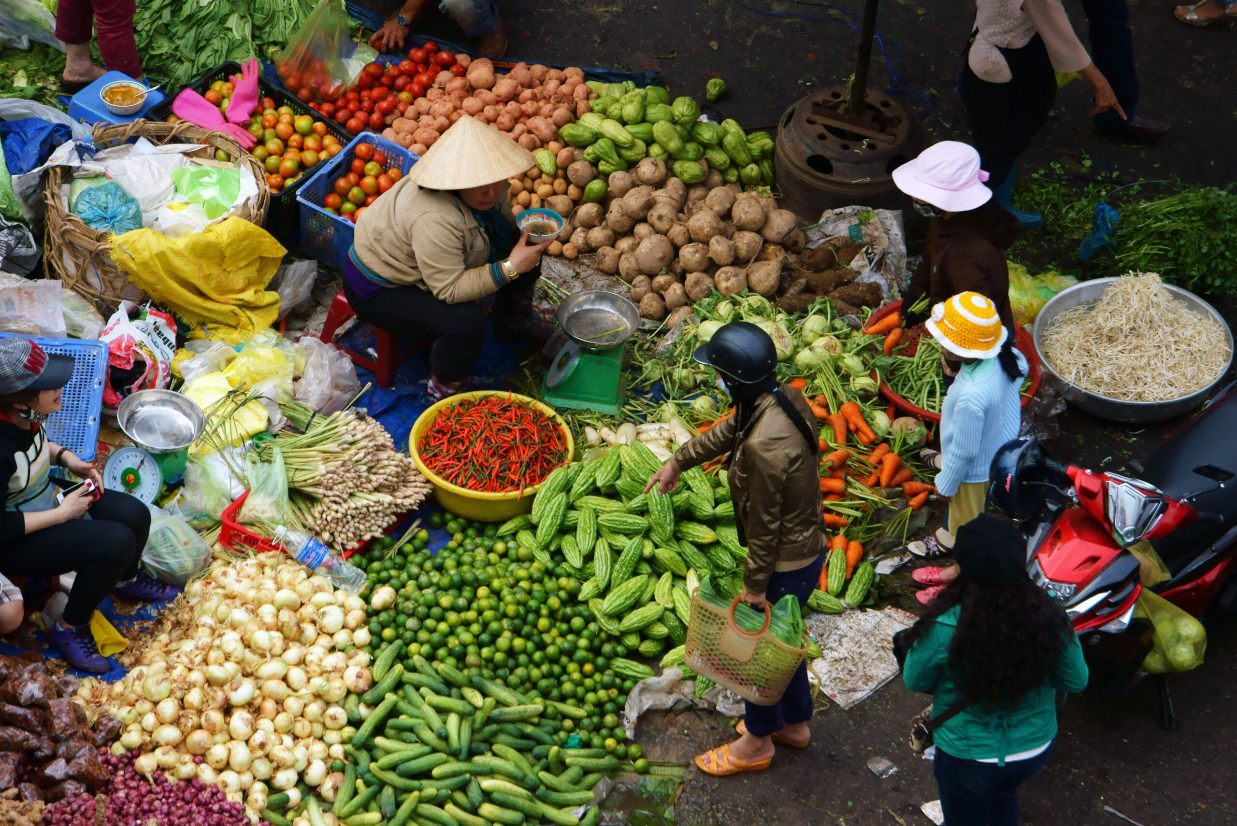

Slide 16
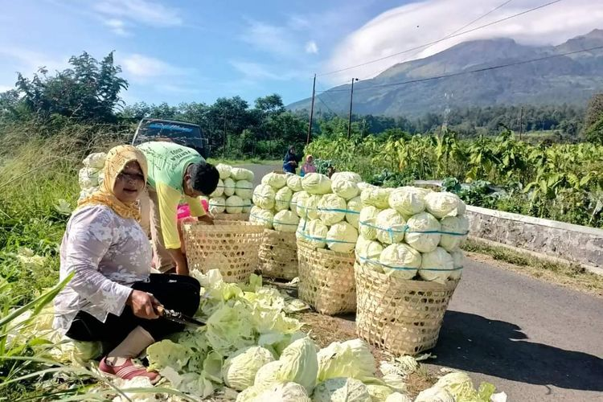

Slide 17
BINHI
is more than a project
it is a MOVEMENT…

Slide 18
B I N H I
REMEMBER OUR ROOTS
Notes:
ALLOW ME TO PRESENT ON BEHALF OF MY TEAM THE UPDATES ON BINHI PROJECT SINCE ITS CONCEPTUALIZATION IN MAY 2024 DURING THE ASIA PEACE INNOVATORS FORUM IN SALZBURG AUSTRIA.
OUR TEAM IS COMPOSED OF JEROME BACTOL, ROBERT BUDIANTO, NGA NGUYEN HONG & MA. ERLINDA VILA. OUR MENTOR IS DR. RABHI ABDESSALEM WHOM WE OWE THE SOLIDIFICATION OF OUR GOALS, OBJECTIVES AND MILESTONES , NOT ONLY FOR THE BINHI PROJECT BUT ALSO FOR OUR PARTICIPATION TO THIS PROJECT ACCELERATOR PROGRAM

